Slide 1


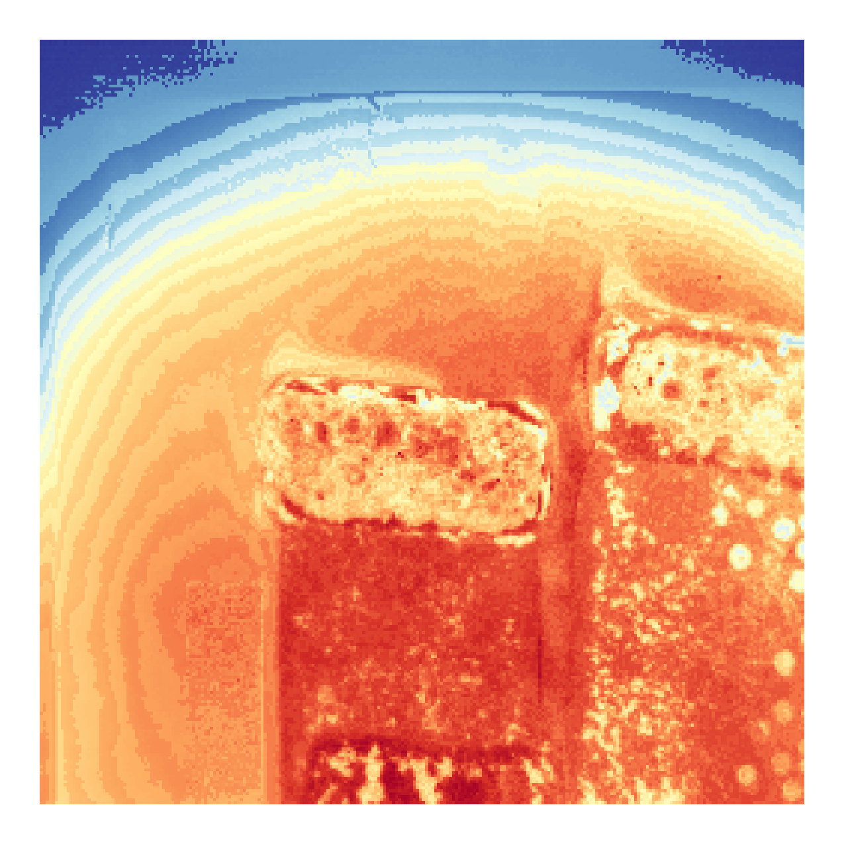
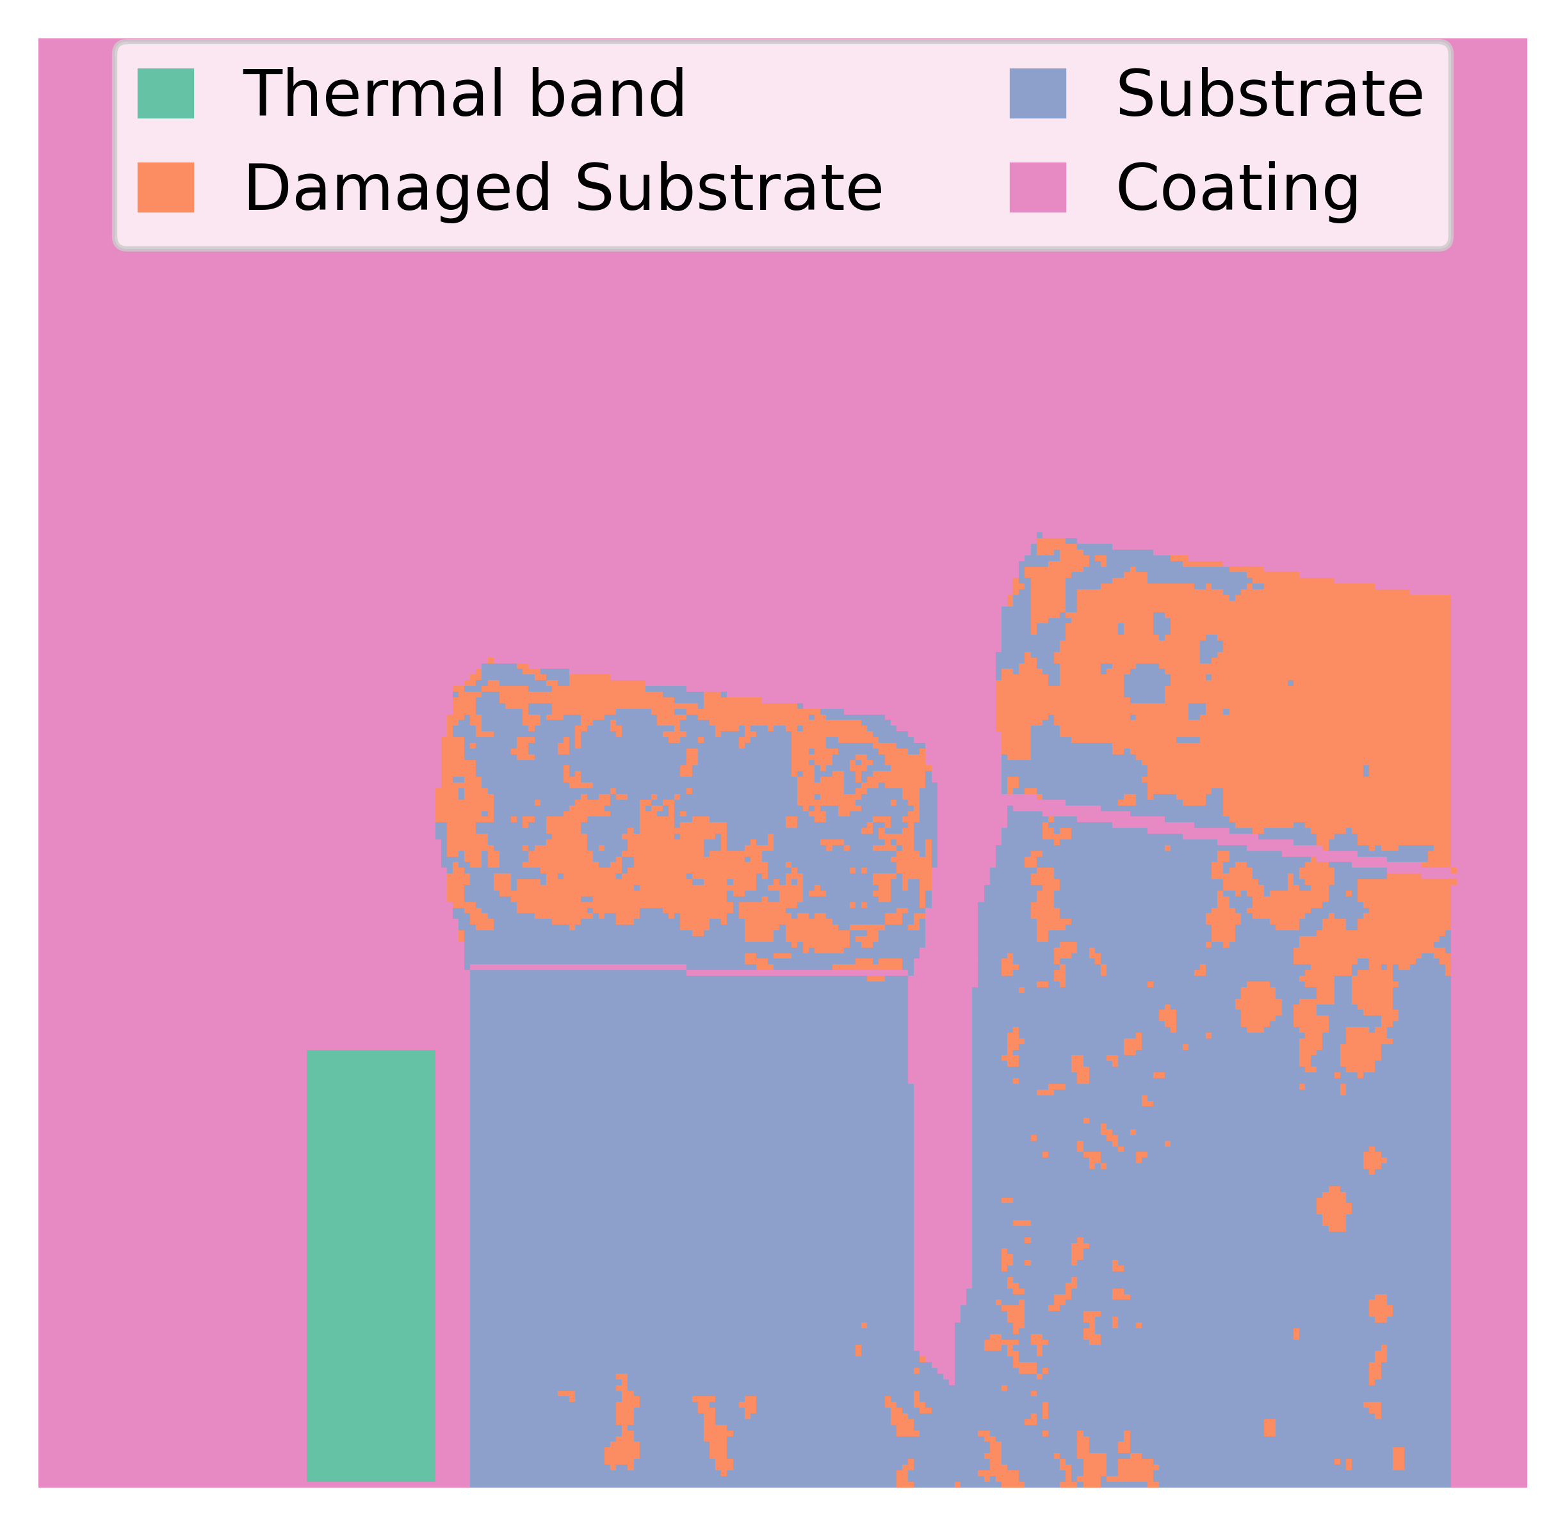
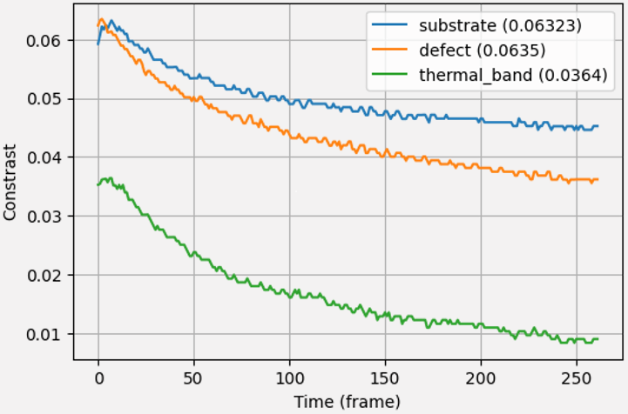

Thickness evaluation and segmentation of coating layer and residuals on concrete and metal surfaces using machine learning
STUDENT WORK
Viswambhar Yasa (65074)
Computational Material Science
Supervisor: M.Sc. Andreas Pestel Examiner: Prof. Dr.-Ing. Hartmut Krause

Slide 2


Content
Motivation
Thermograms extraction and manipulation
Thermogram pre-processing
Machine learning for object segmentation
Thermograms post-processing
Machine learning for thickness evaluation
Conclusion
References
Demo and Appendix

Slide 3
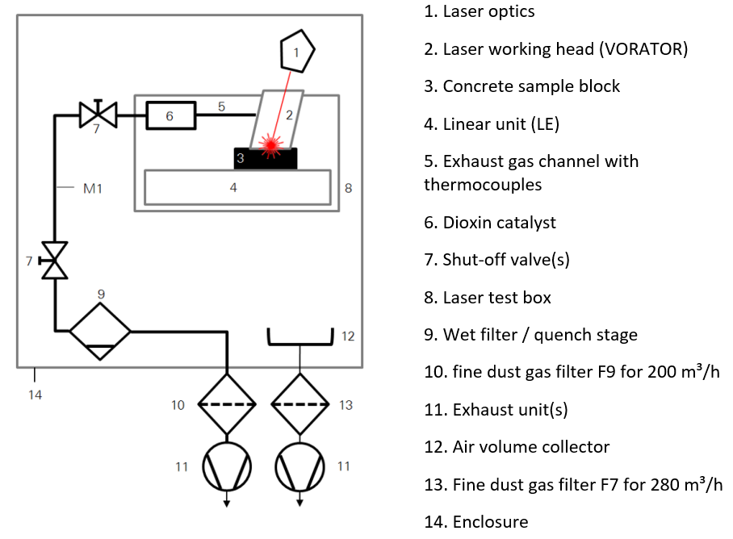
Motivation
Development of efficient practices for complex, large-scale decommissioning processes of nuclear power plants.
Automated removal of coating from the surface using lasers.
Necessity
Some of the surfaces are coated with an epoxy-based resin that contains Polychlorinated Biphenyls (PCB).
PCBs are carcinogenic and neurotoxic agents.
Due to prolonged exposure to radiation, the coatings become radioactive.
Laser-based coating removal consists of high-power lasers which can thermally destroy all chemicals and the fumes can be filtered from any radioactive dust.
Laser-based coating removal experiment. [1]
In this project, we are building a system that works on thermographic principles and machine learning algorithms to ensure that the paint is completely removed by checking the surface for any paint residues, based on which the laser can be recalibrated.

Slide 4
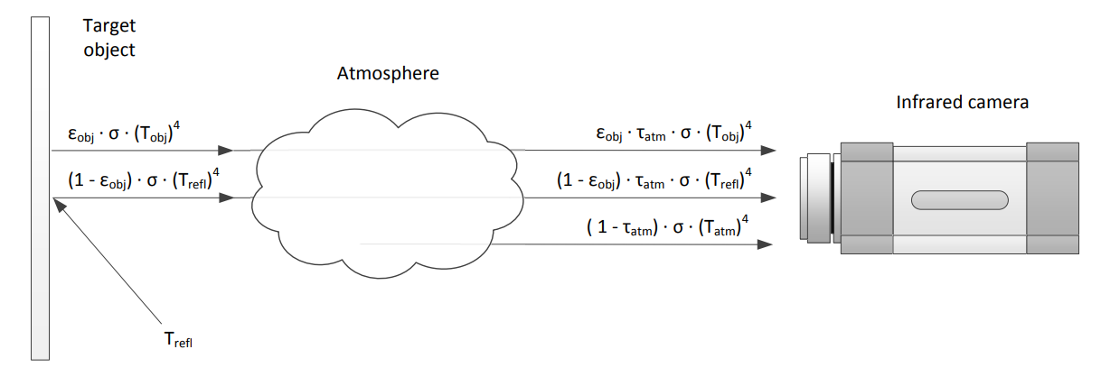
Infrared Thermography
Any object with a temperature above absolute temperature (0 K) emits electromagnetic radiation which is not visible to the human eye.
Thermography measured the temperature of the object from infrared radiation which is characterized through wavelength (λ).
The radiation from the object depends on the emissivity.
Emissivity is the measure of the emitted thermal energy with respect to a black body.
Atmospheric window takes into consideration the loss of thermal energy to the surrounding atmosphere.
Illustration of atmospheric window [2]
Where τ =Transmittance,ε =Emissivity ,T = Temperature

Slide 5
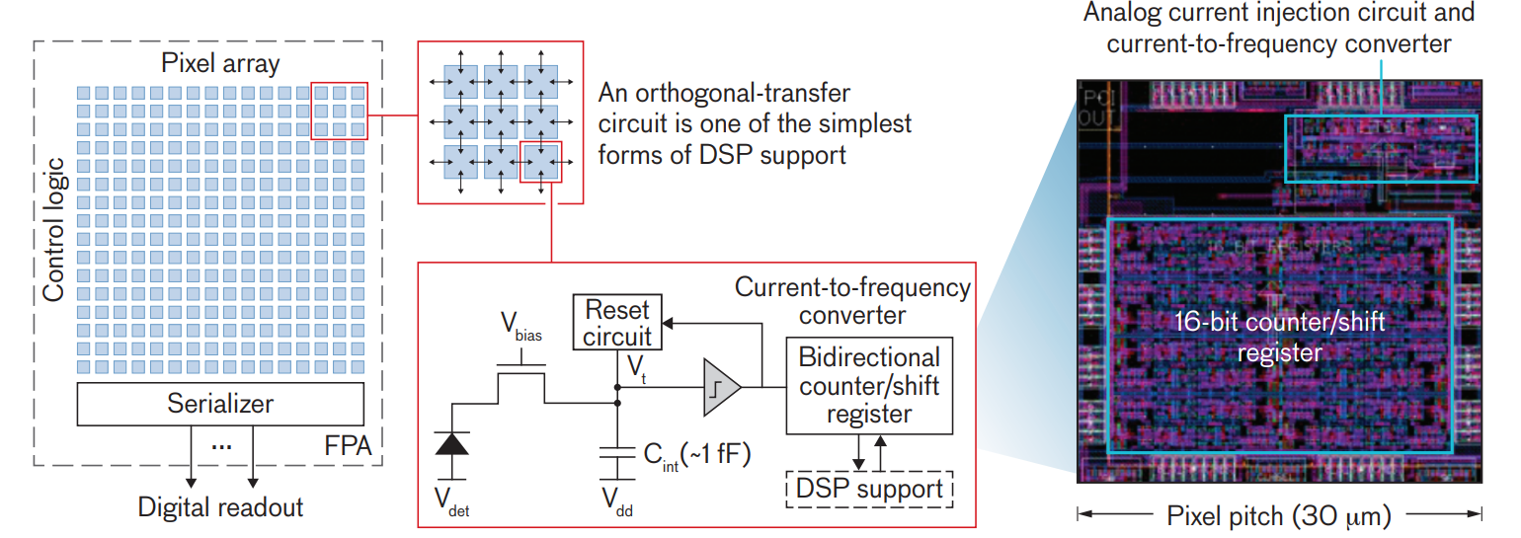
Infrared Thermal Sensors
Basic Architecture
Modern infrared thermal sensors use semi-conductor (transistors) which convert the radiation into an electrical signal.
Focal Plane Array (FPA) Architecture. [3]
An Analog-to-Digital Converter (ADC) converts the electrical frequency into digital format.

Slide 6
Infrared Thermal Sensors
Technical specifications of the thermal sensors
Properties | VarioTherm | Optris 640p
Type of detector | Cooled, FPA | Uncooled, FPA
Optical resolution | 256x256 pixels | 640x480 pixels
Spectral range | 3.4 - 5.0 (μm) | 8 - 14 (μm)
Temperature range | -25 to 1200 ֯C | -20 to 1500 ֯C
Frame rate | 50 Hz | 32 Hz
Emissivity | 0.1 to 1 adjustable | -
Humidity | - | 20-80% non-condensing
Thermal sensitivity | 100 mK | 20 mK
Accuracy | ± 2 K | ± 2 %

Slide 7
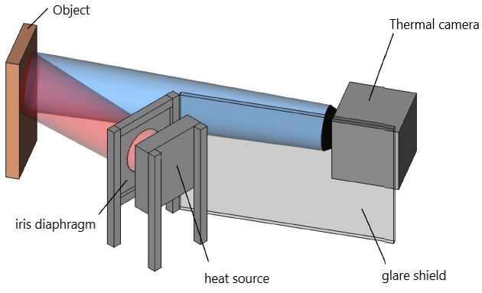
Experiment Setup
The experiment setup is a special type of pulsed thermography known as Heat-Flow thermography
List of Heat-Flow thermography experiments with different sources and angles
Exp no | Camera | Radiation source | Incident angel
01 | VarioTherm | Halogen Lamp | 0 ֯
02 | VarioTherm | Halogen Lamp | 22.50 ֯
03 | VarioTherm | Halogen Lamp | 45 ֯
04 | VarioTherm | Infrared-spotlight | 0 ֯
05 | VarioTherm | Infrared-spotlight | 22.50 ֯
06 | VarioTherm | Infrared-spotlight | 45 ֯
07 | VarioTherm | Flash lamp | 0 ֯
Experiment setup. [4]

Slide 8
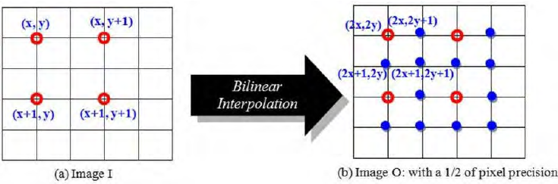
Thermograms Extraction
VarioTherm
Thermal video (.irb)
Binary file
Thermograms
Data file reading
Sequence block data
Video info extraction
Image extraction
Image read byte
Read byte
Temperature interpolation
Bilinear interpolation. [5]
f = pixcel_1 * (1.0 / length_of_pixcels)
pixcel_temperature = interpolation_temp [ pixcel_2+ 1] * f + interpolation_temp [ pixcel_2 ] * (1.0 - f)

Slide 9
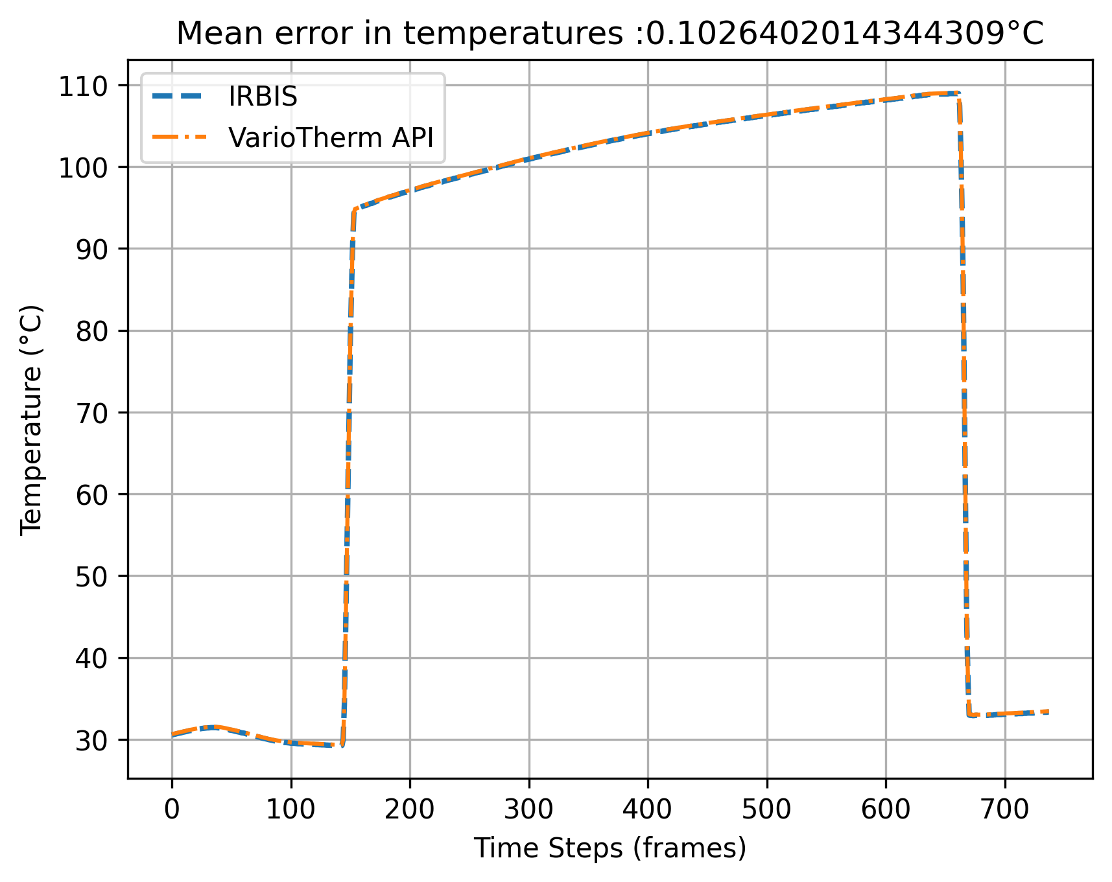
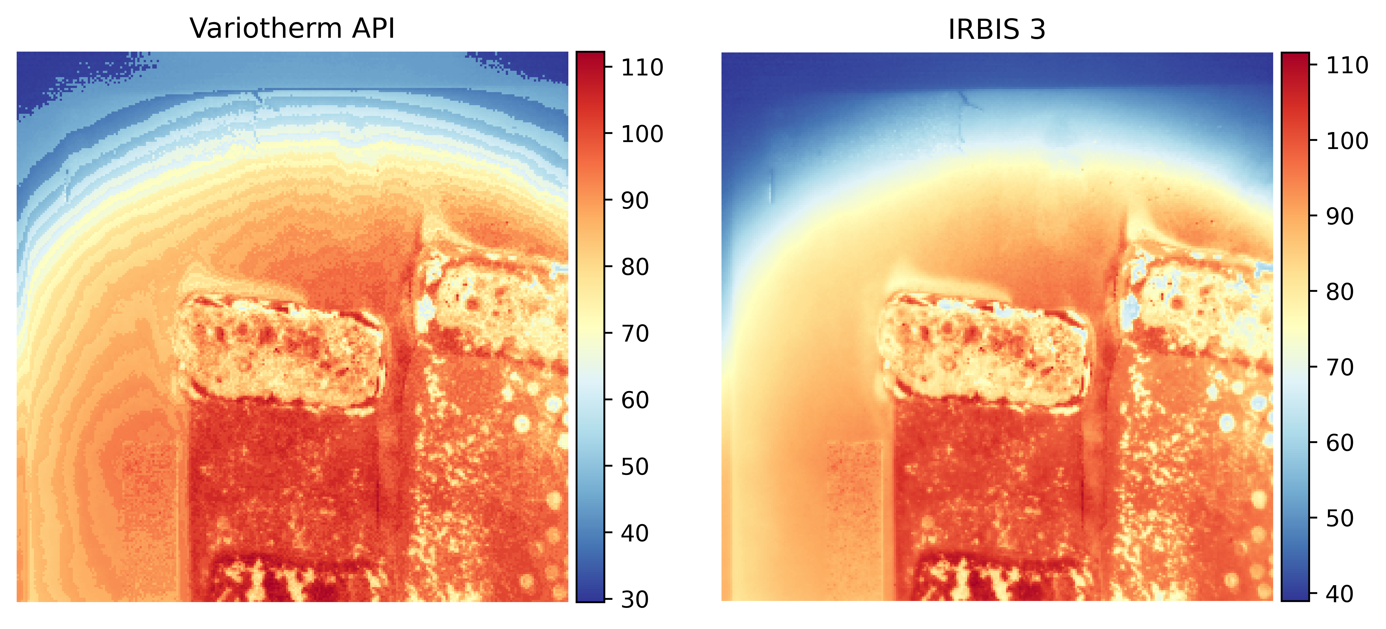
Thermograms Extraction
VarioTherm: Python API vs IRBIS professional
Thermograms at time step 500 extracted from VarioTherm python API and IRBIS professional
Thermal profile of python API and IRBIS professional

Slide 10
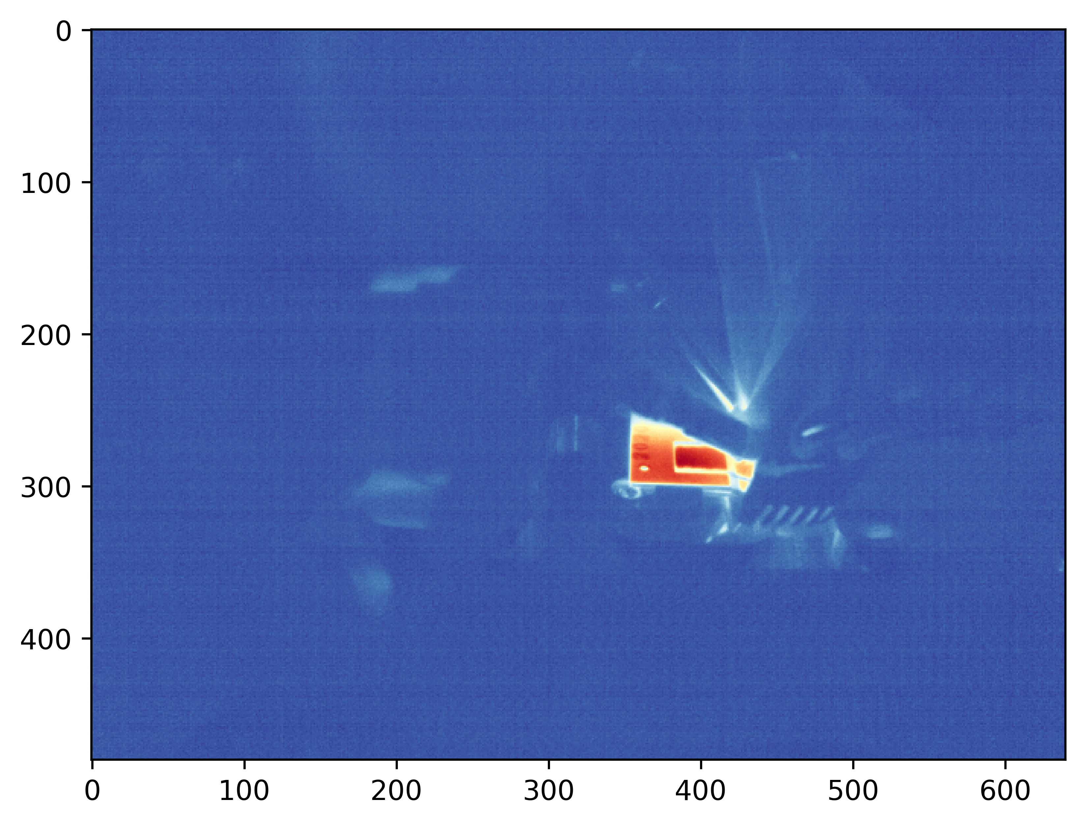
Thermograms Extraction
Optris
Thermal video (.ravi)
Normalization
Identifying high intensity pixels
Optris thermal video (.ravi) raw video (left) and normalized video with a color palette (right)

Slide 11
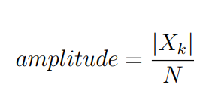
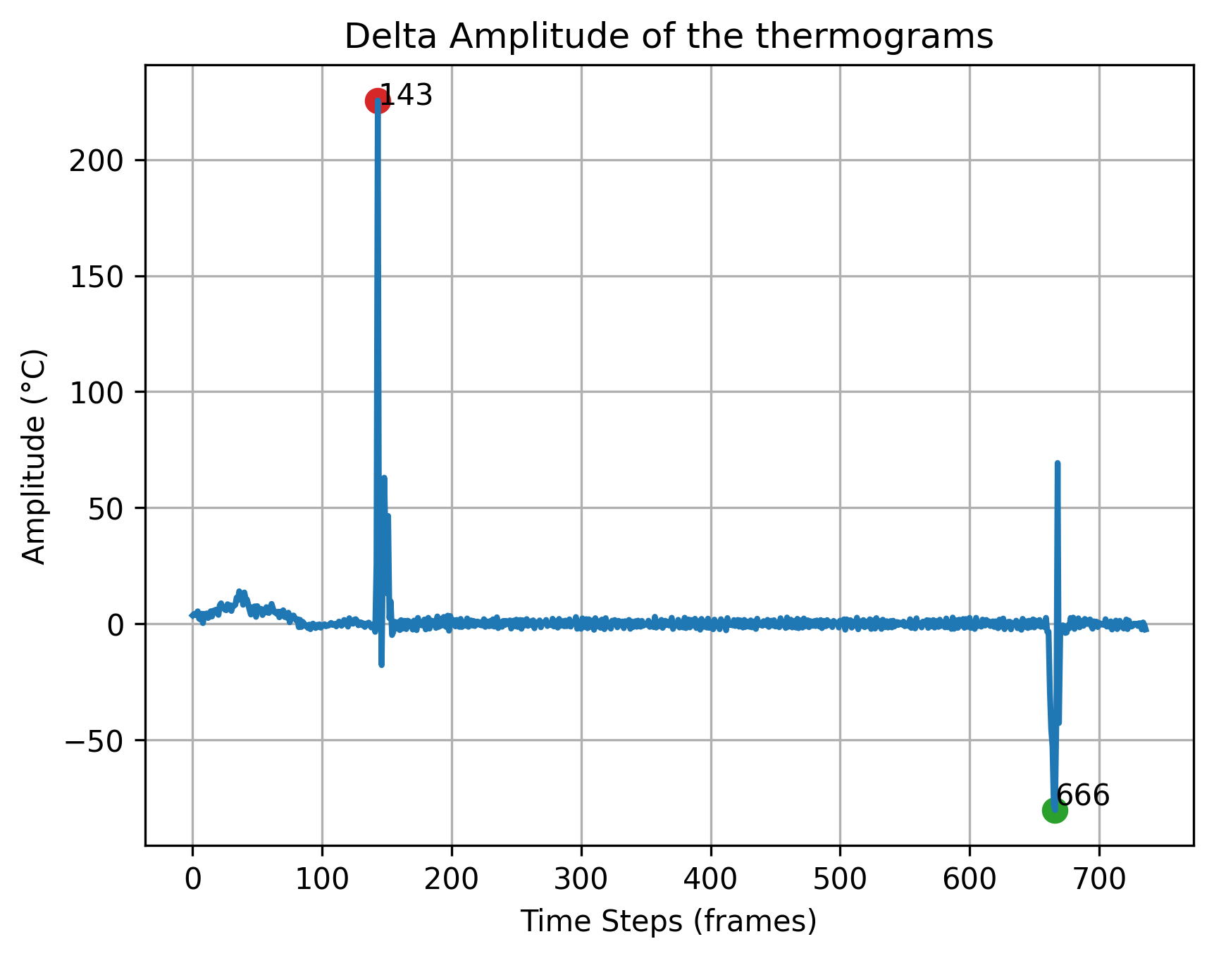
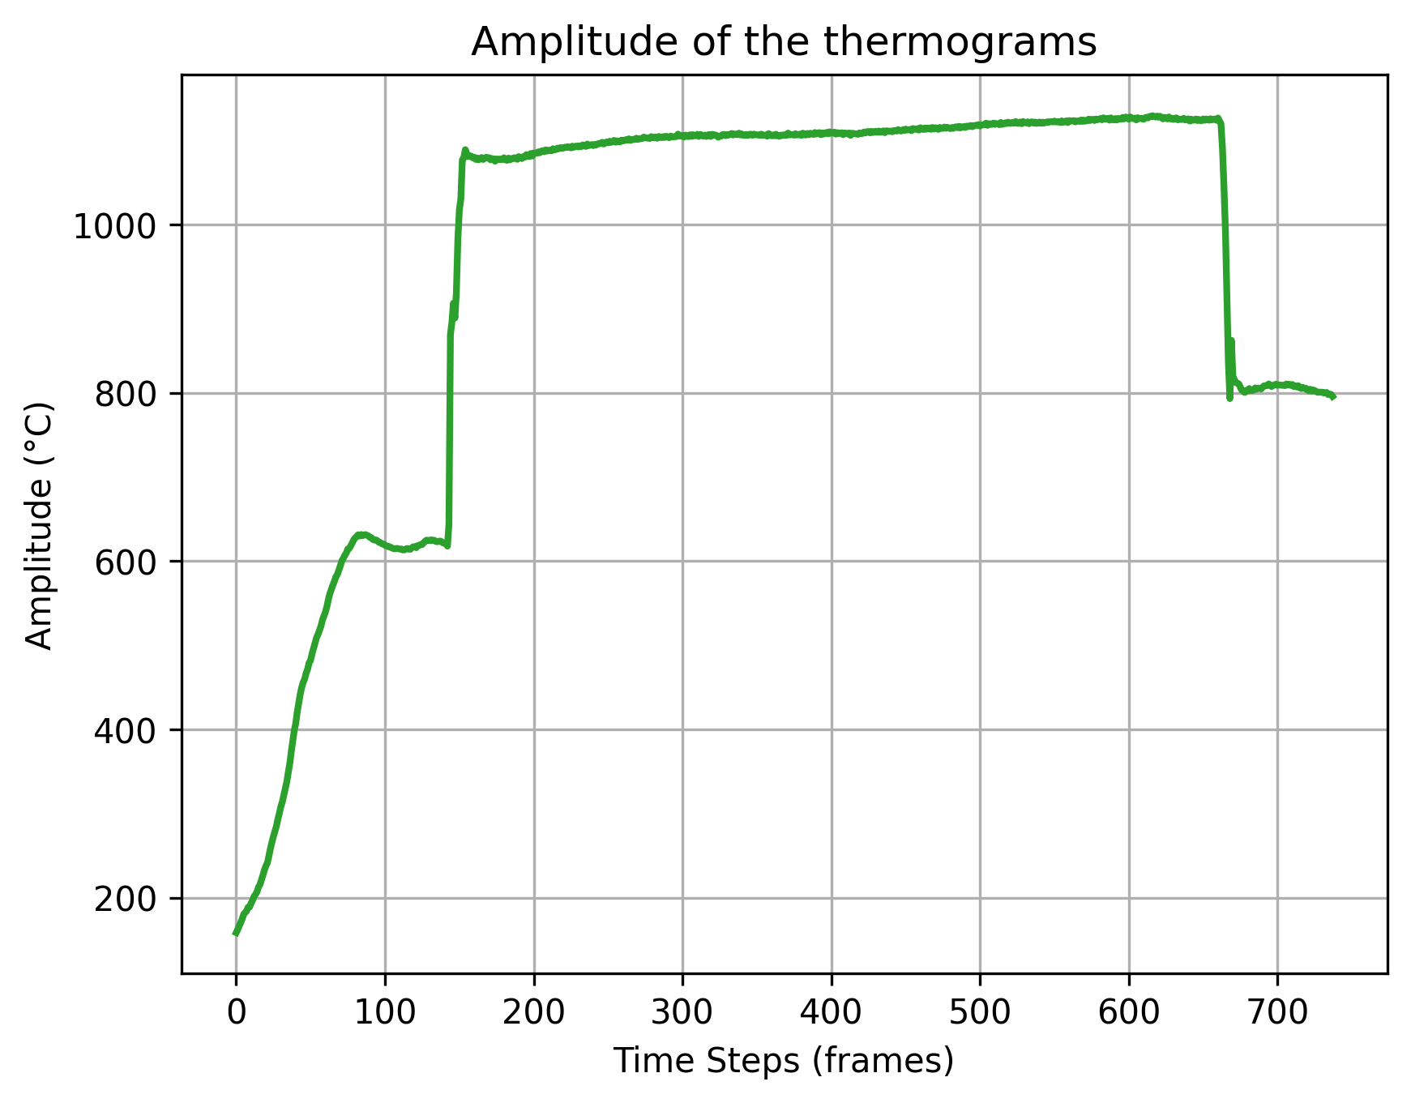
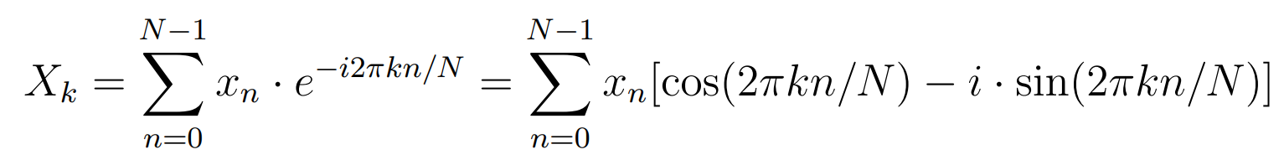
Thermograms Pre-processing
Identification of phases
N = number of samples ,
n = current sample ,
k = current frequency,
x_{n} = the sine value at sample n,
X_{k} = the DFT which includes information on both amplitude and phase.
Fast Fourier Transformation.[6]

Slide 12
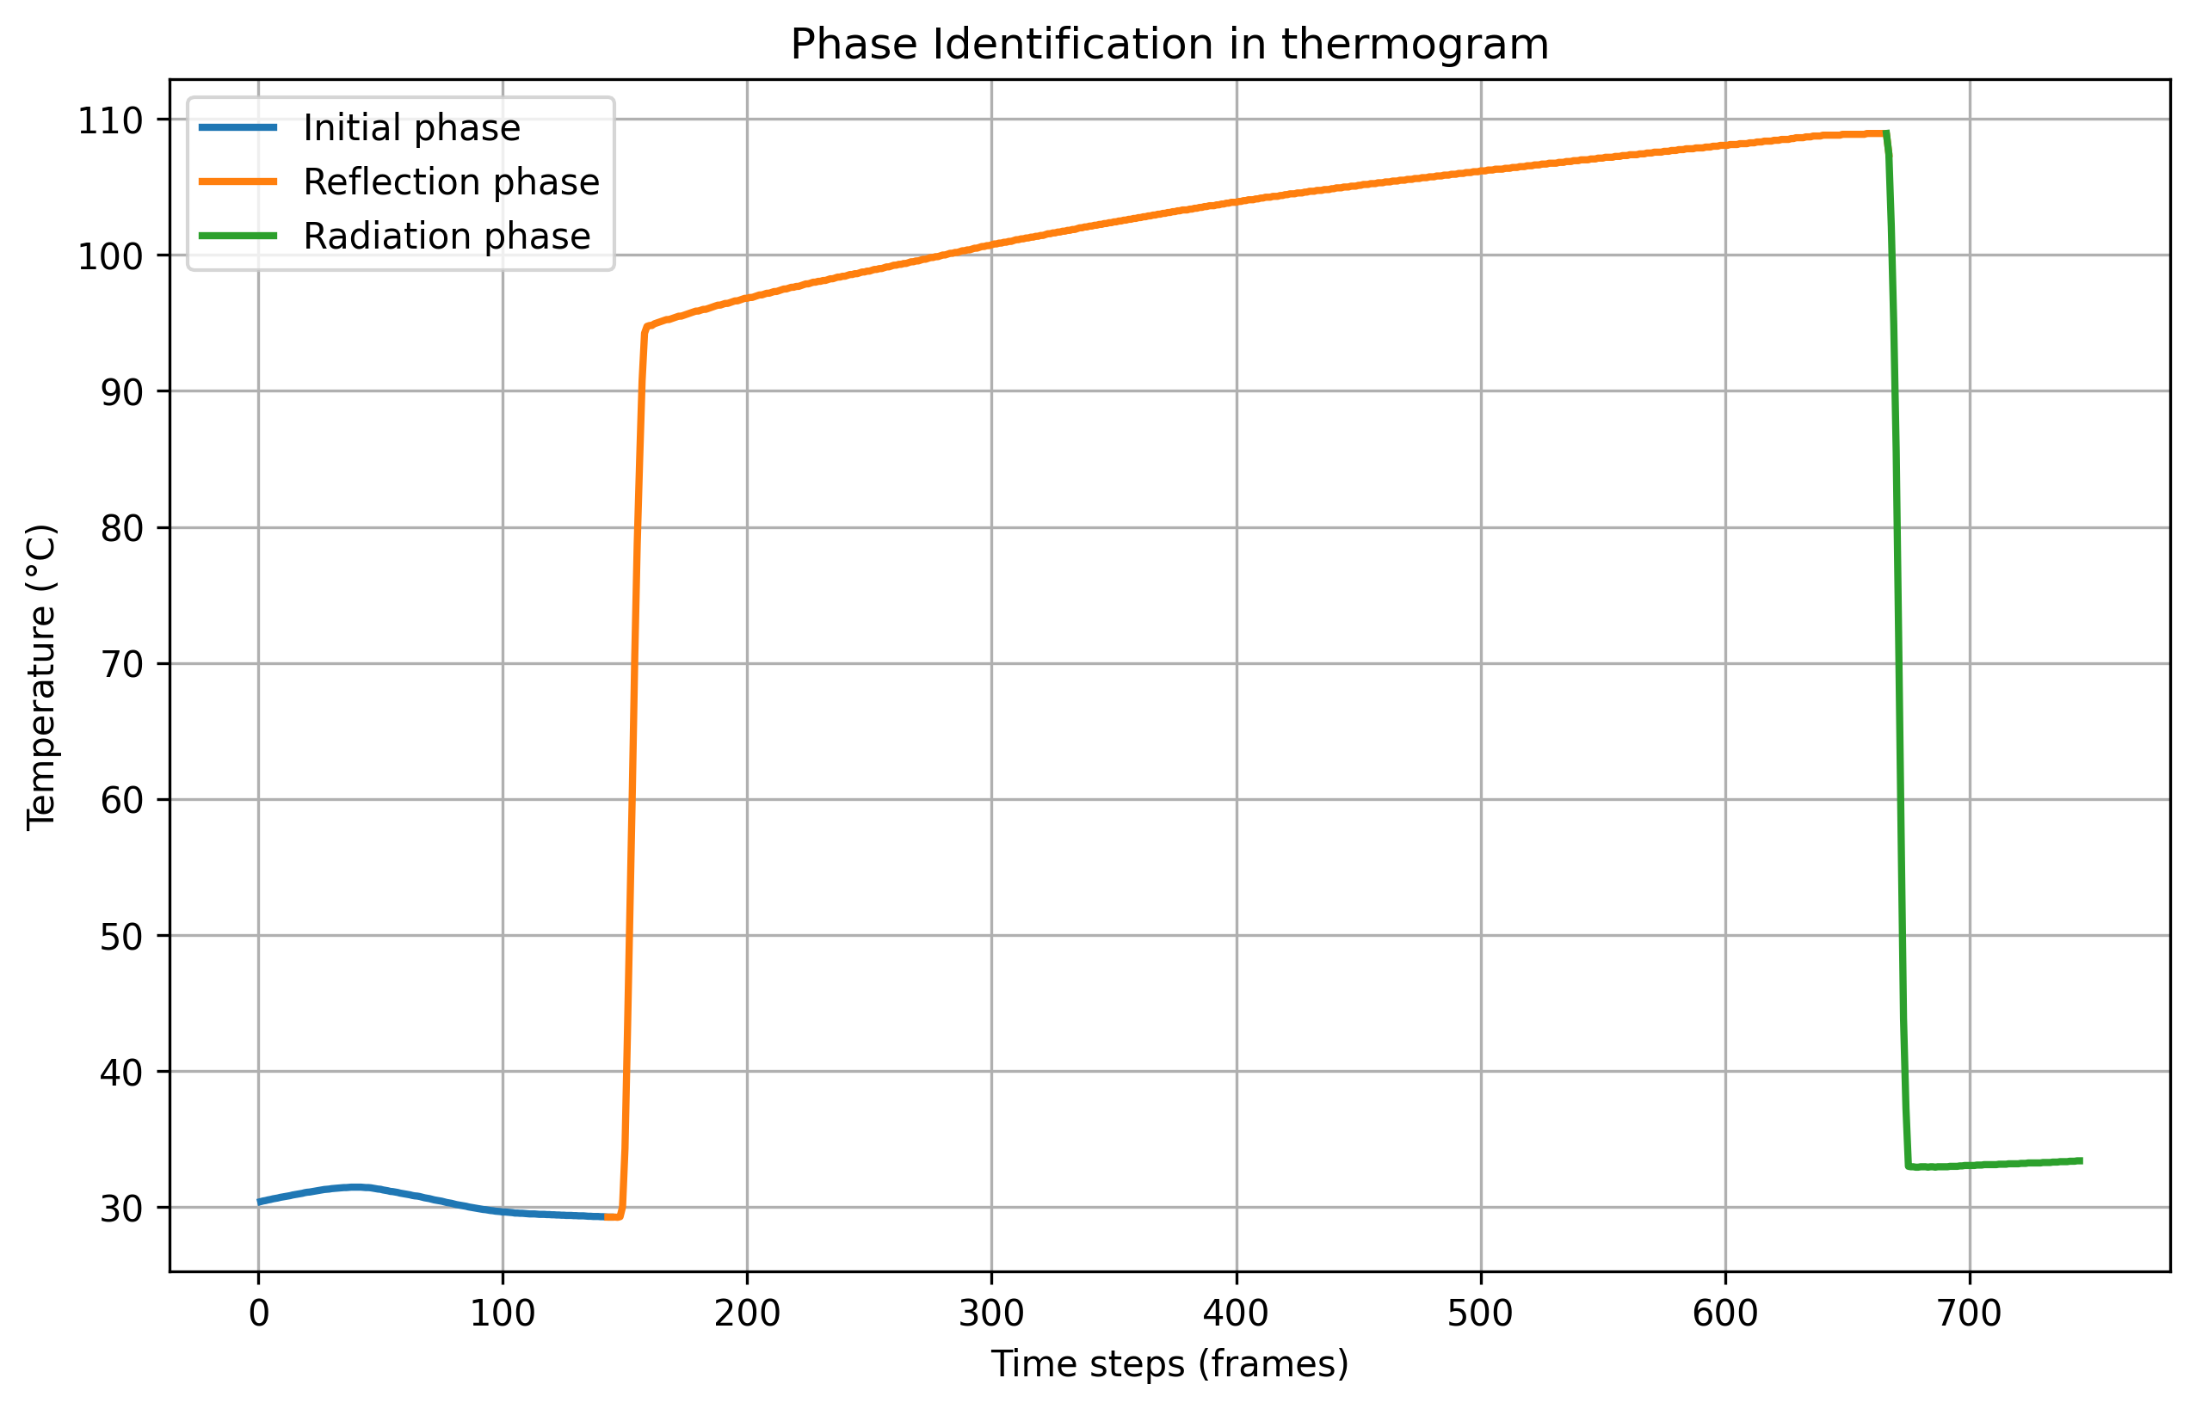
Thermograms Pre-processing
Identification of phases
Reflection phase: For object segmentation (identification of features in thermogram).
Radiation phase: For thickness or depth evaluation

Slide 13
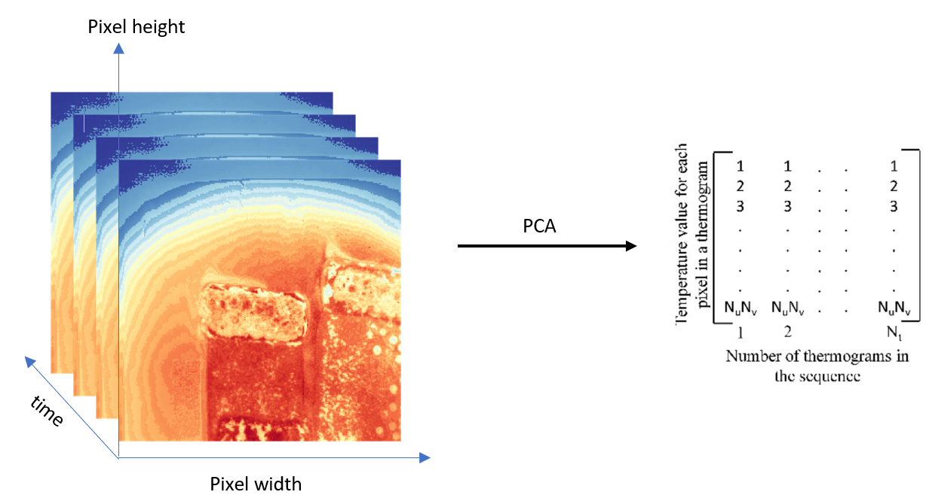
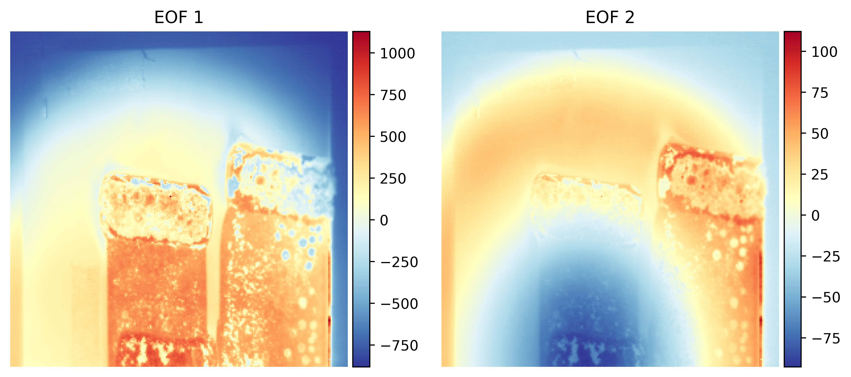
Thermograms Pre-processing
Dimension Reduction
Empirical Orthogonal Functions
Principle component analysis (PCA) algorithm
Rearranging 3d array to 2d array.
Performing covariance operation.
Extracting eigenvector and eigenvalues of the covariance matrix.
Performing single value decomposition on eigenvector matrix to obtain the Empirical orthogonal matrix

Slide 14
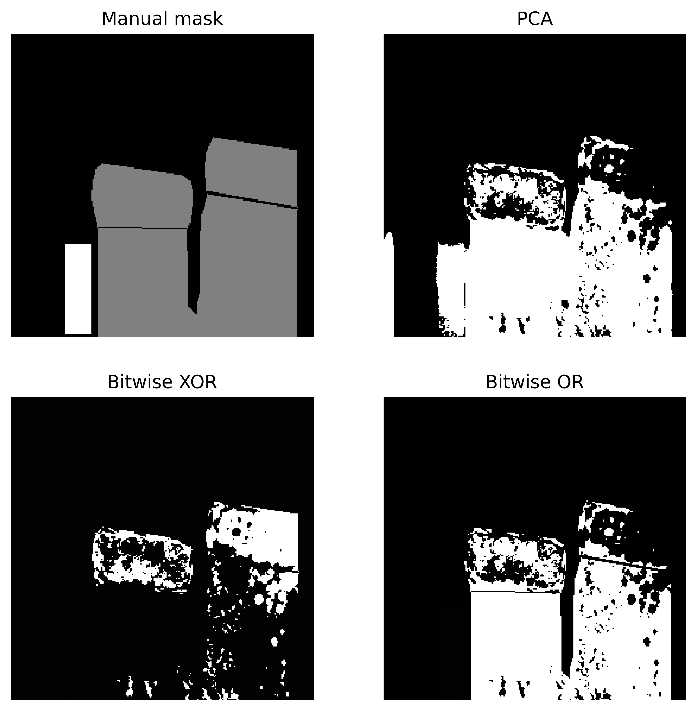
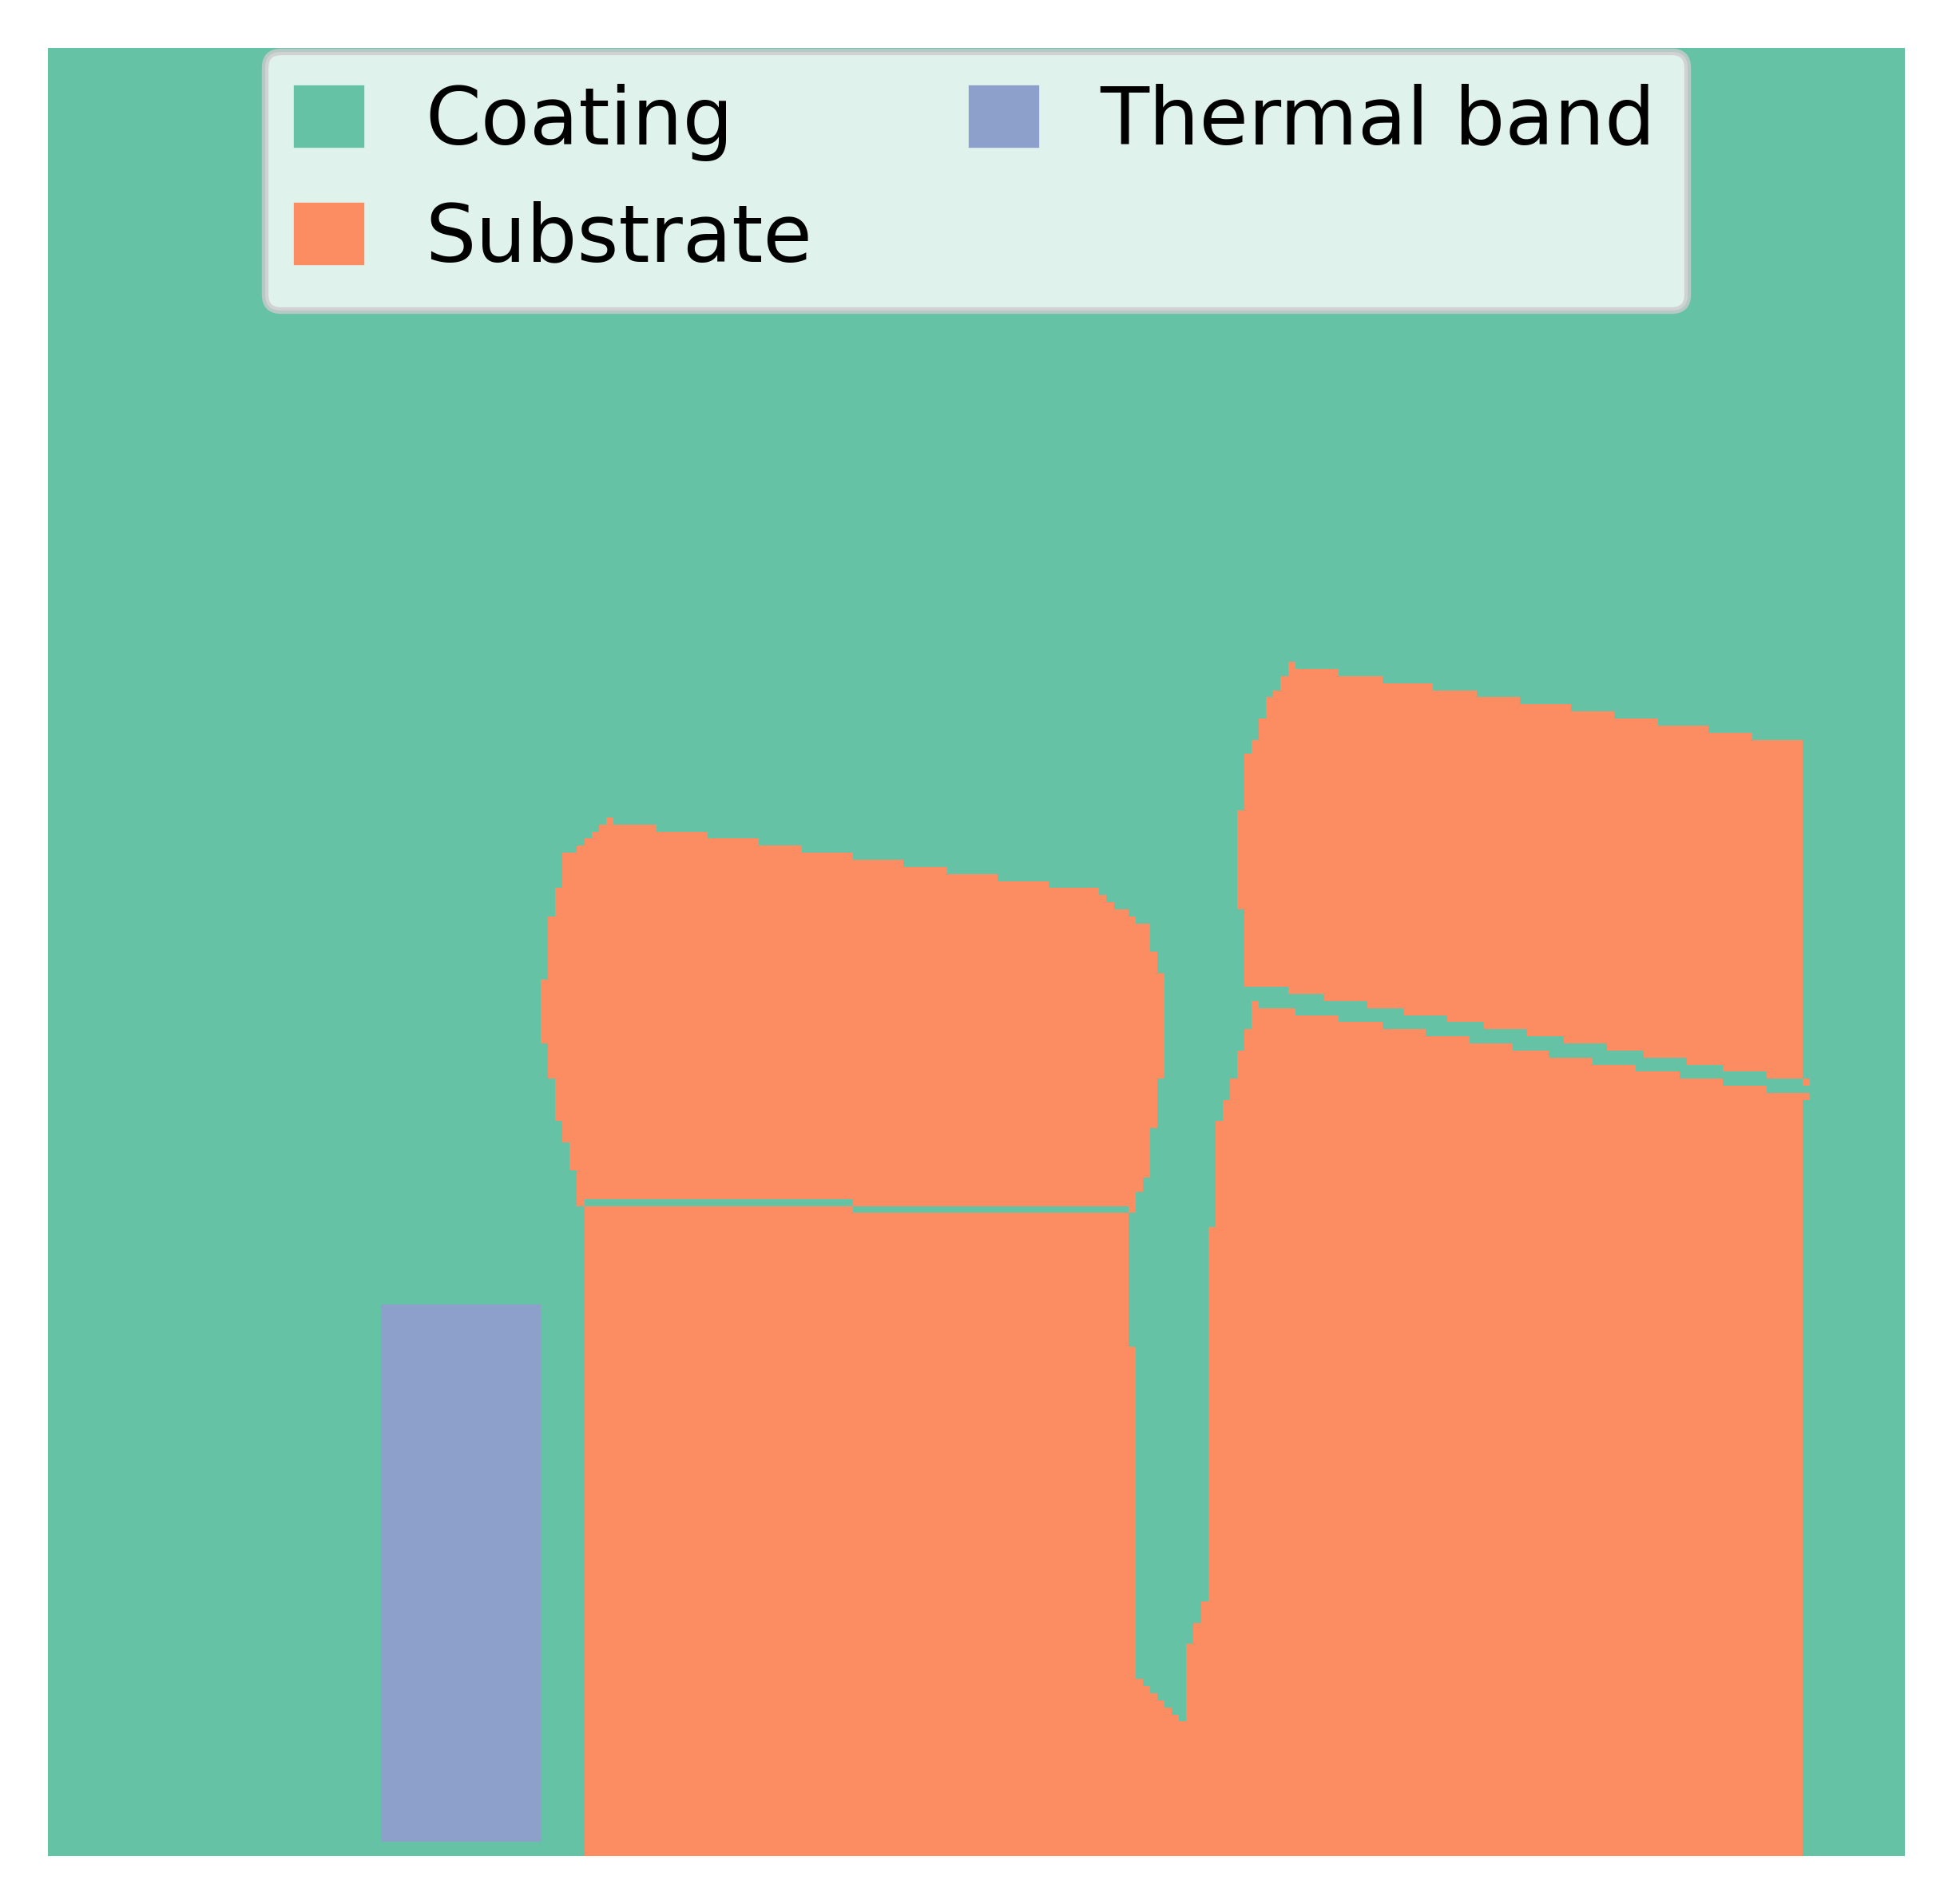
Thermogram Dataset
Segmentation Mask
Manual segmentation mask generated using labelMe
Performing morphological and logical operations to extract features from the thermogram

Slide 15
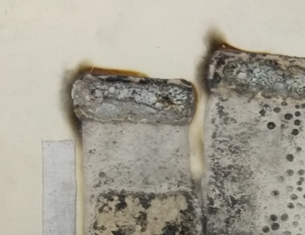
Thermogram Dataset
Segmentation Mask
Experiment object (left), Input thermogram (center), and expected segmentation mask (right)

Slide 16
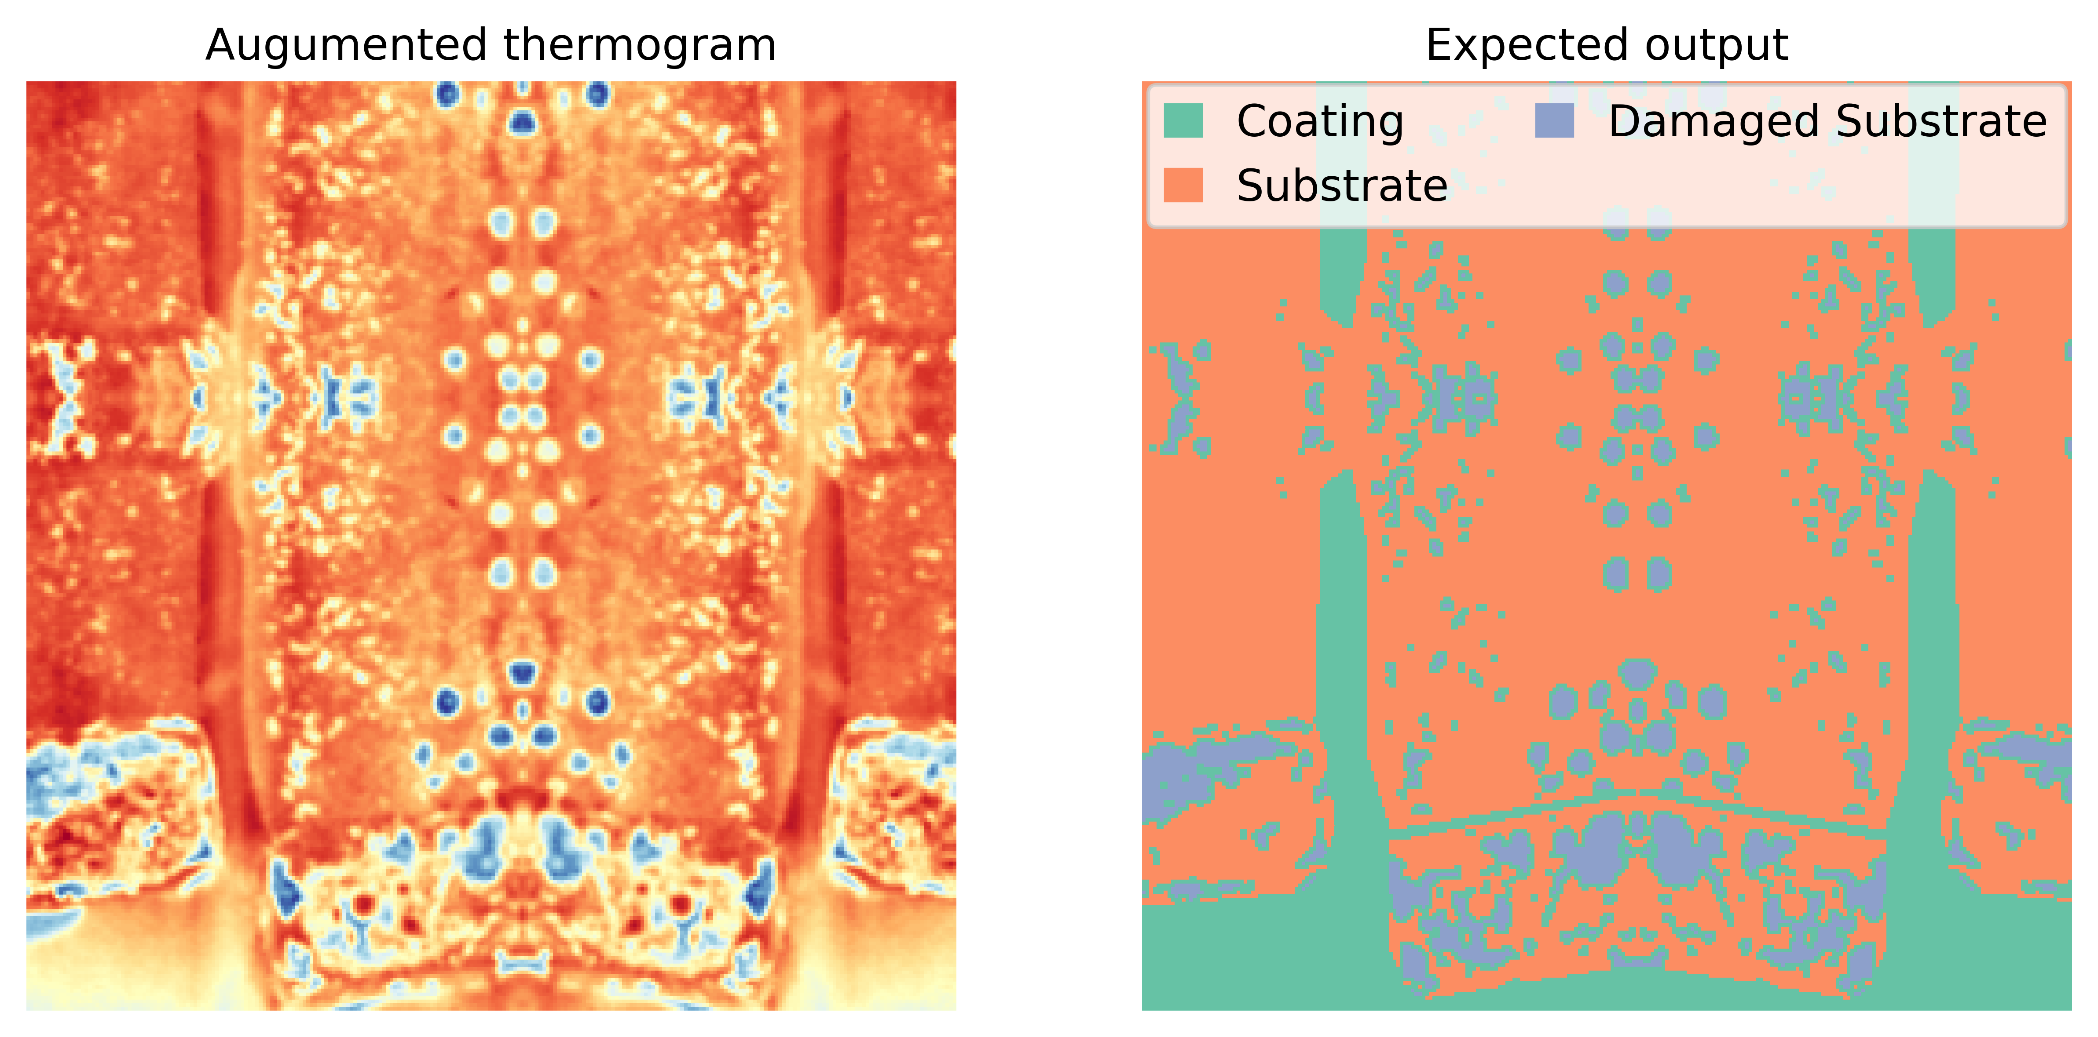
Thermogram Dataset
Data Augmentation
To generate more complex data by performing operations like flipping, rotation, and shearing on the original dataset.
Input augmented thermogram (left) and expected segmentation output (right)

Slide 17
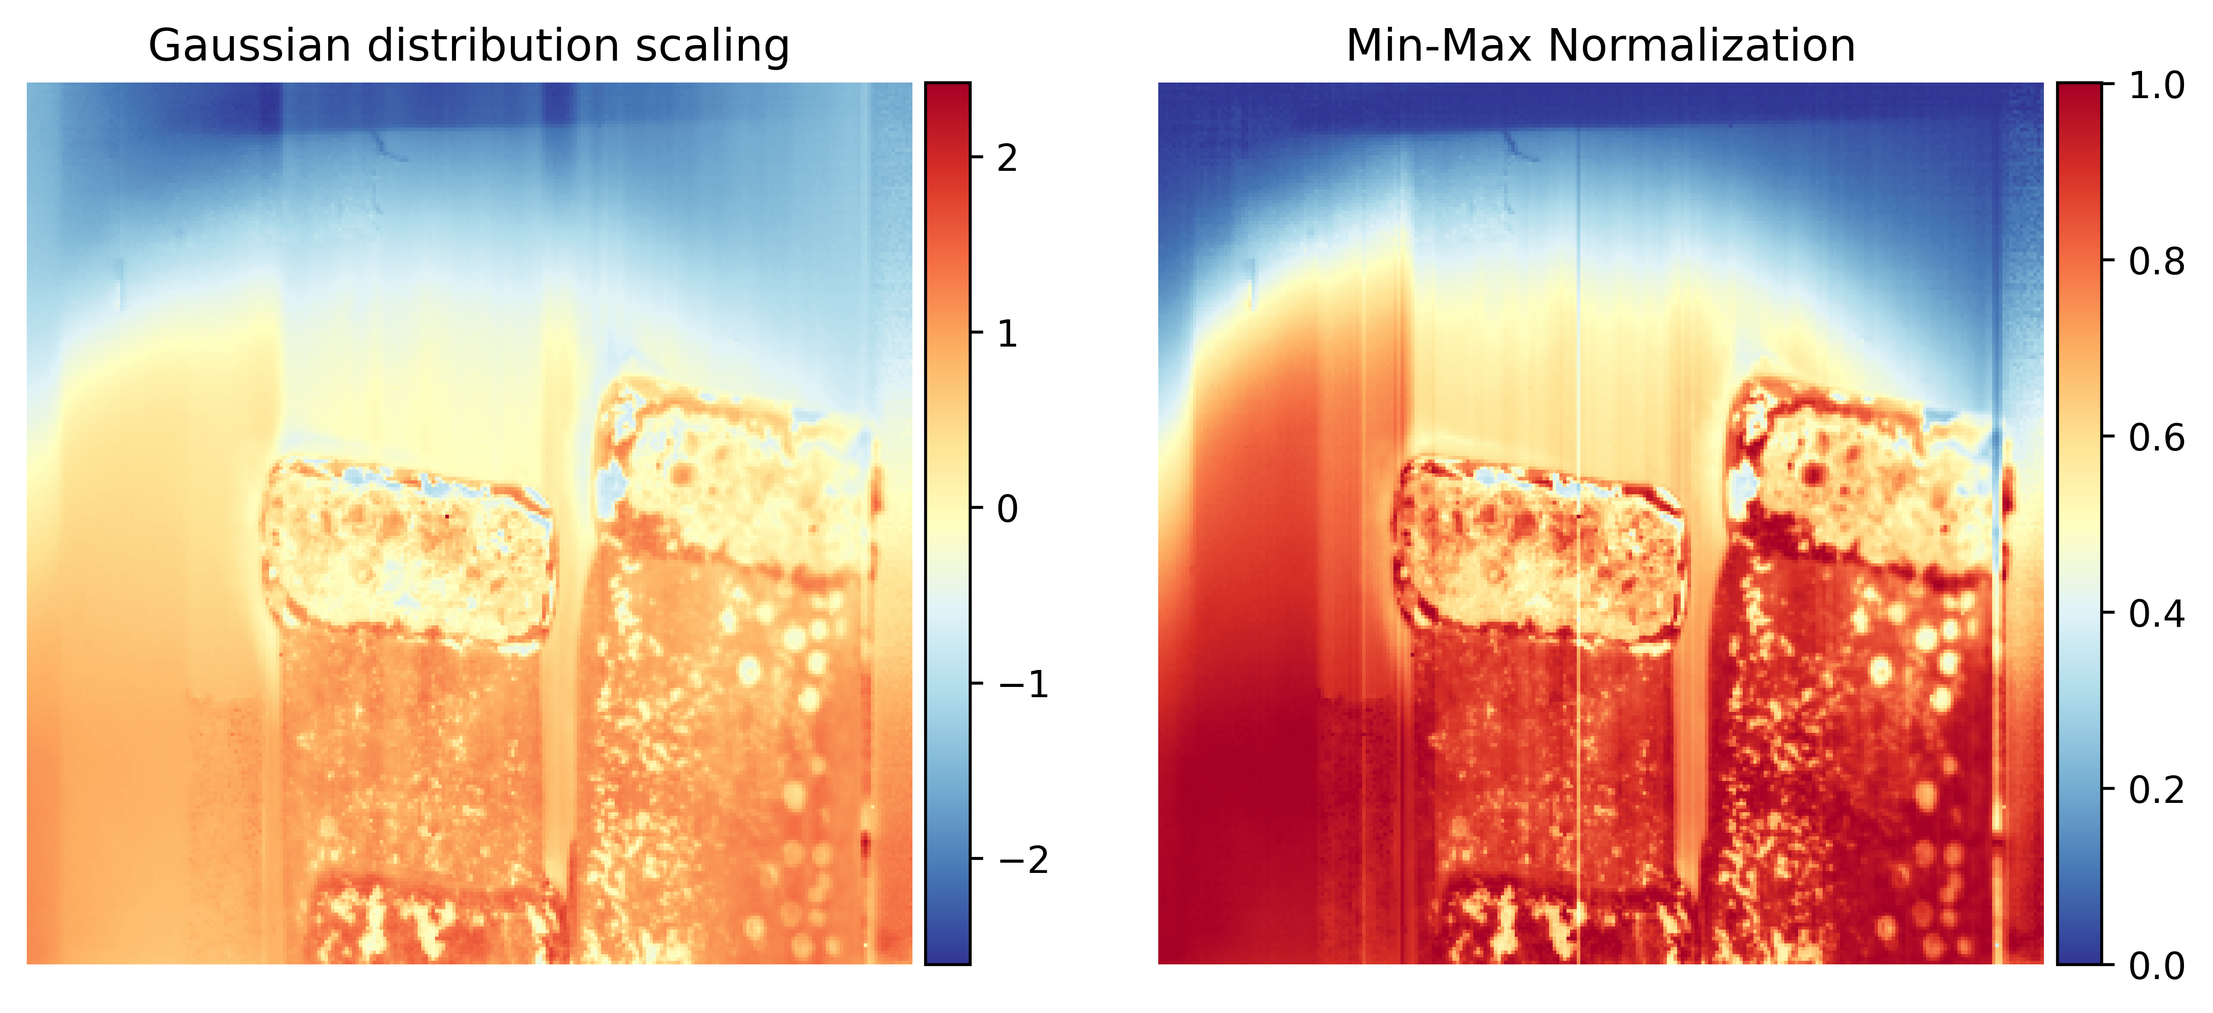
Thermogram Dataset
Data Standardization
Data Standardization is performed to reduce the noise in the datasets and avoid vanishing gradients during training.
Thermograms standardization

Slide 18
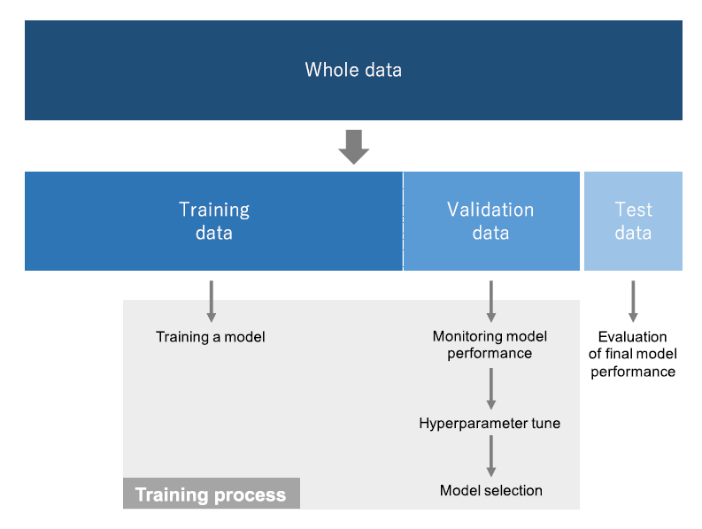
Thermogram Dataset
Splitting datasets
Dataset | Augmentation | Size (No of thermograms)
Training | Yes | 12,500
Validation | No | 4,500
Test | Yes | 5,000
Dataset splitting process. [7]

Slide 19
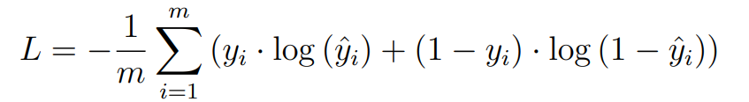
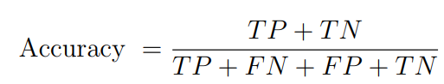
Object Segmentation - Neural Network Basics
Loss Function and accuarcy :
The loss function for multi-class classification is cross-entropy. [8]
Where
y is the actual output.
ŷ is the predicted output.
m are number of samples
CM | Actual Positive (1) | Actual Negative (0)
Predicted positive (1) | True Positives (TP) | False Positives (FP)
Predicted Negative (0) | False Negatives (FN) | True Negatives (TN)
Confusion Matrix (CM)

Slide 20
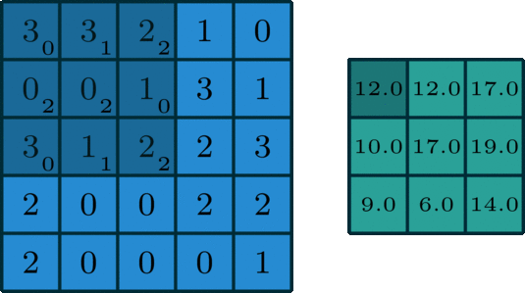


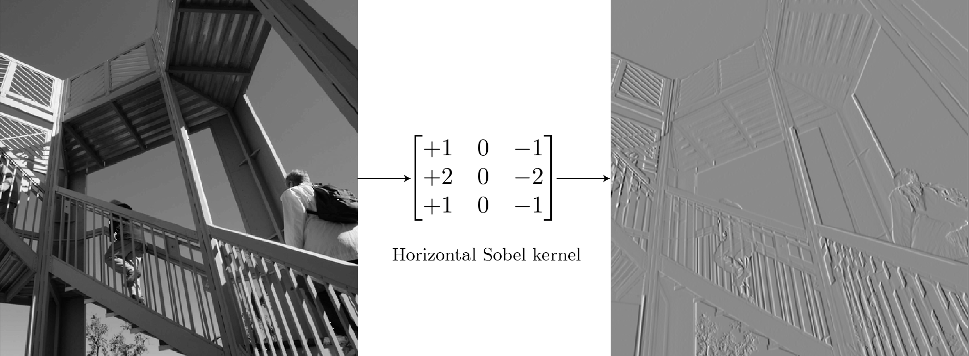
Object Segmentation - Neural Network Basics
Convolution Layer
In each layer many number of filter or kernels are used to extract features.
Padding size, stride, number of filter and filter size are the hyperparameters of convolution layer.
Convolution operation [8]
Convolution operation with padding (left) and stride (right) [8]
Feature extraction using kernel [8]

Slide 21
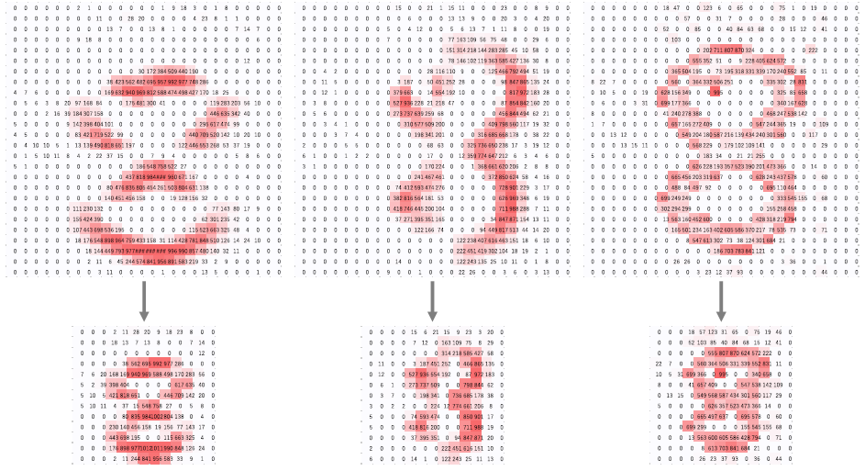

Object Segmentation - Neural Network Basics
Pooling layer:
To prevent overfitting, a pooling layer is applied after the convolution layer.
Max, Average is different types of pooling layers.
Pooling layer removes distortion in inputs and preserves essential features.
Max pooling operation [8]
Polling operation to show the reduction in noise [8]

Slide 22
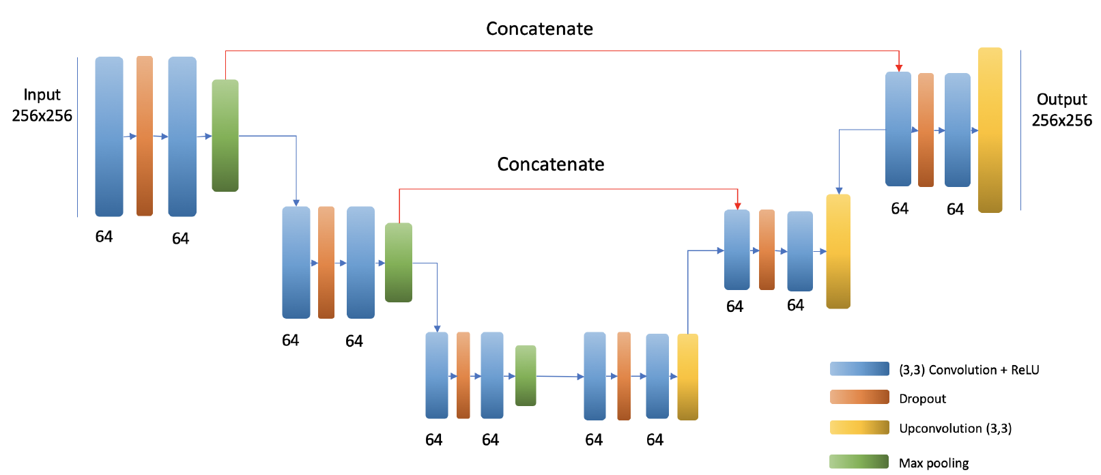
Object Segmentation
U Net (Architecture):
A basic U-Net architecture with encoder and decoder [14]
Trainable parameters | Non-Trainable parameters | Total Parameters
4,629,396 | 0 | 4,629,396

Slide 23
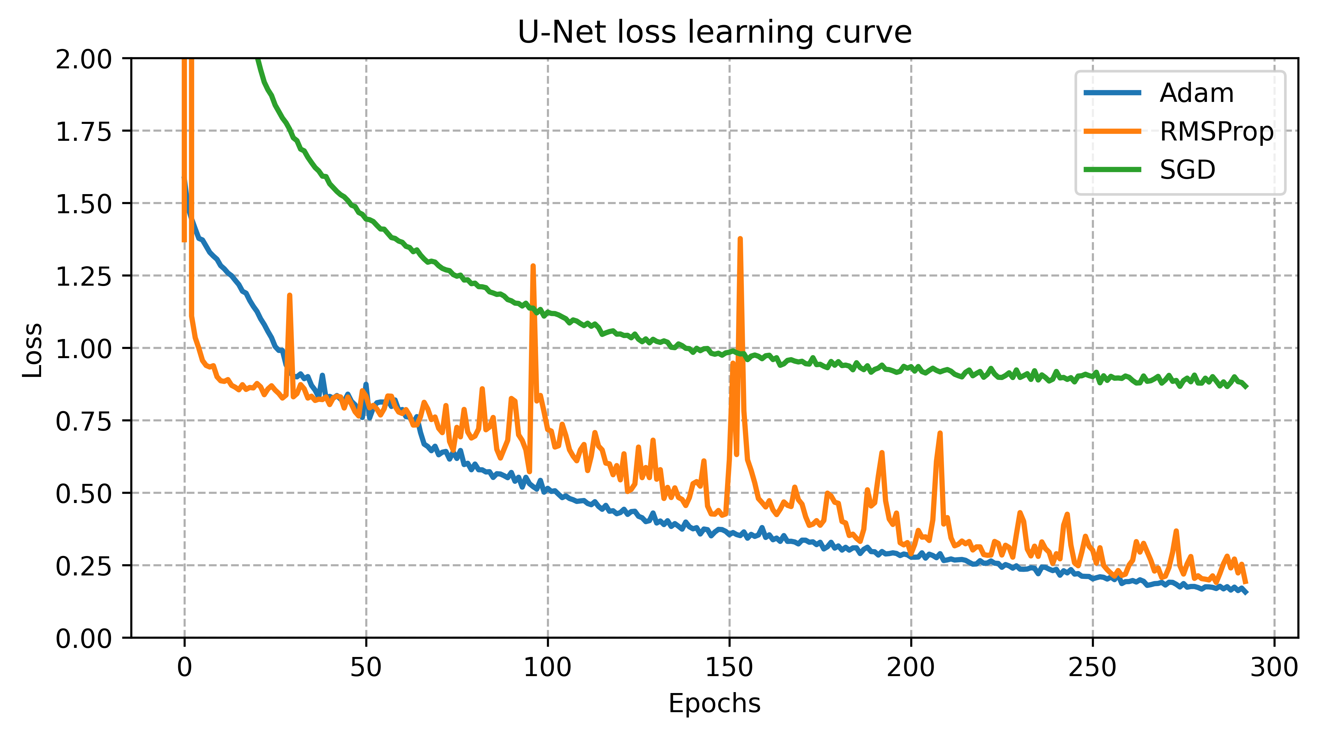
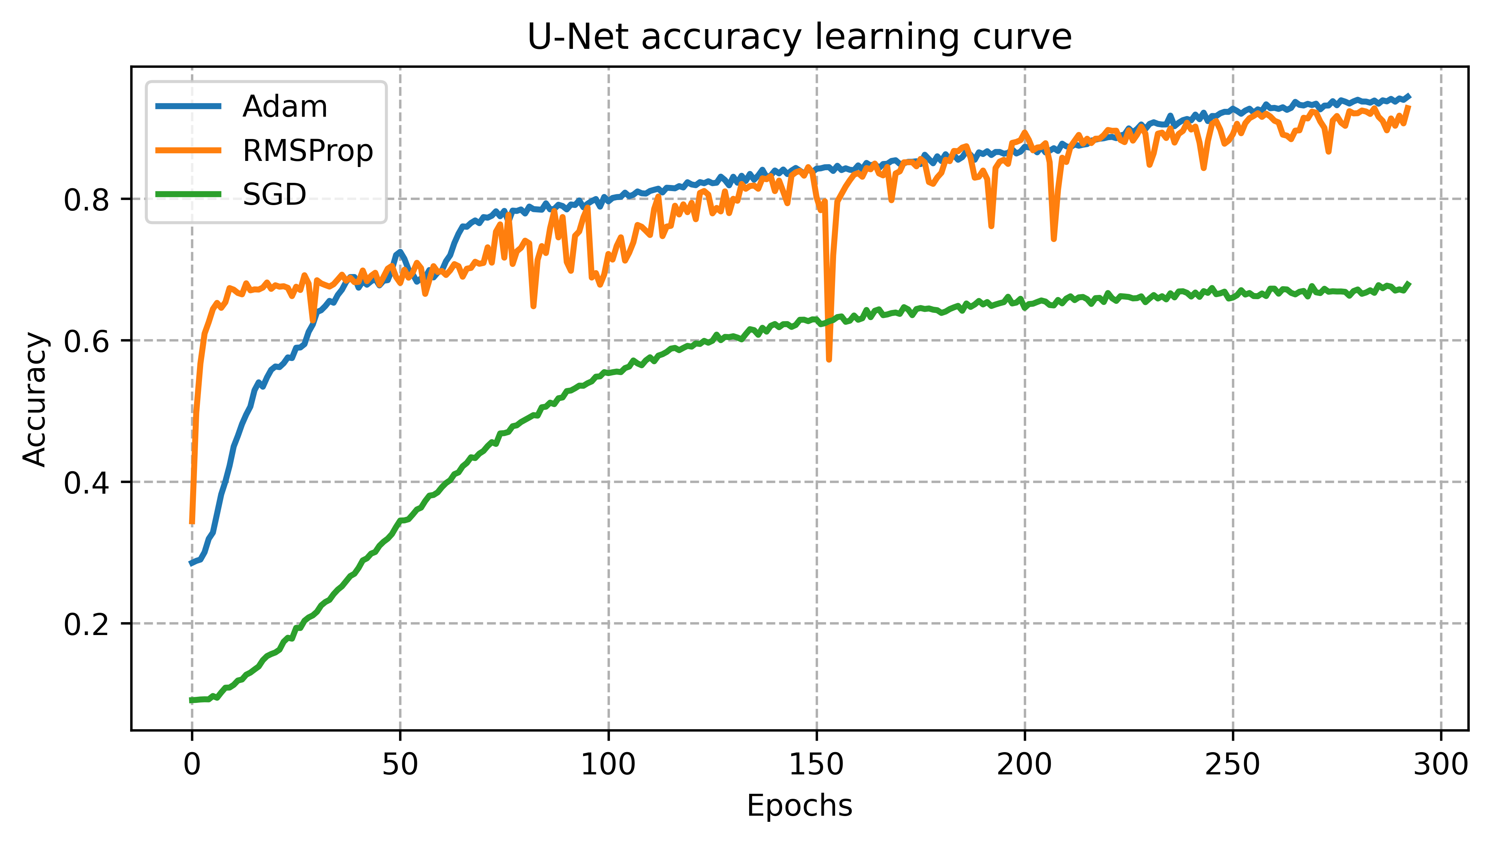
Object Segmentation
U Net (Experimentation- Optimizers):
Hyperparameters
Batch Size | Learning rate | Filter size | Optimizer
32 | 0.001 | 4 | ?

Slide 24
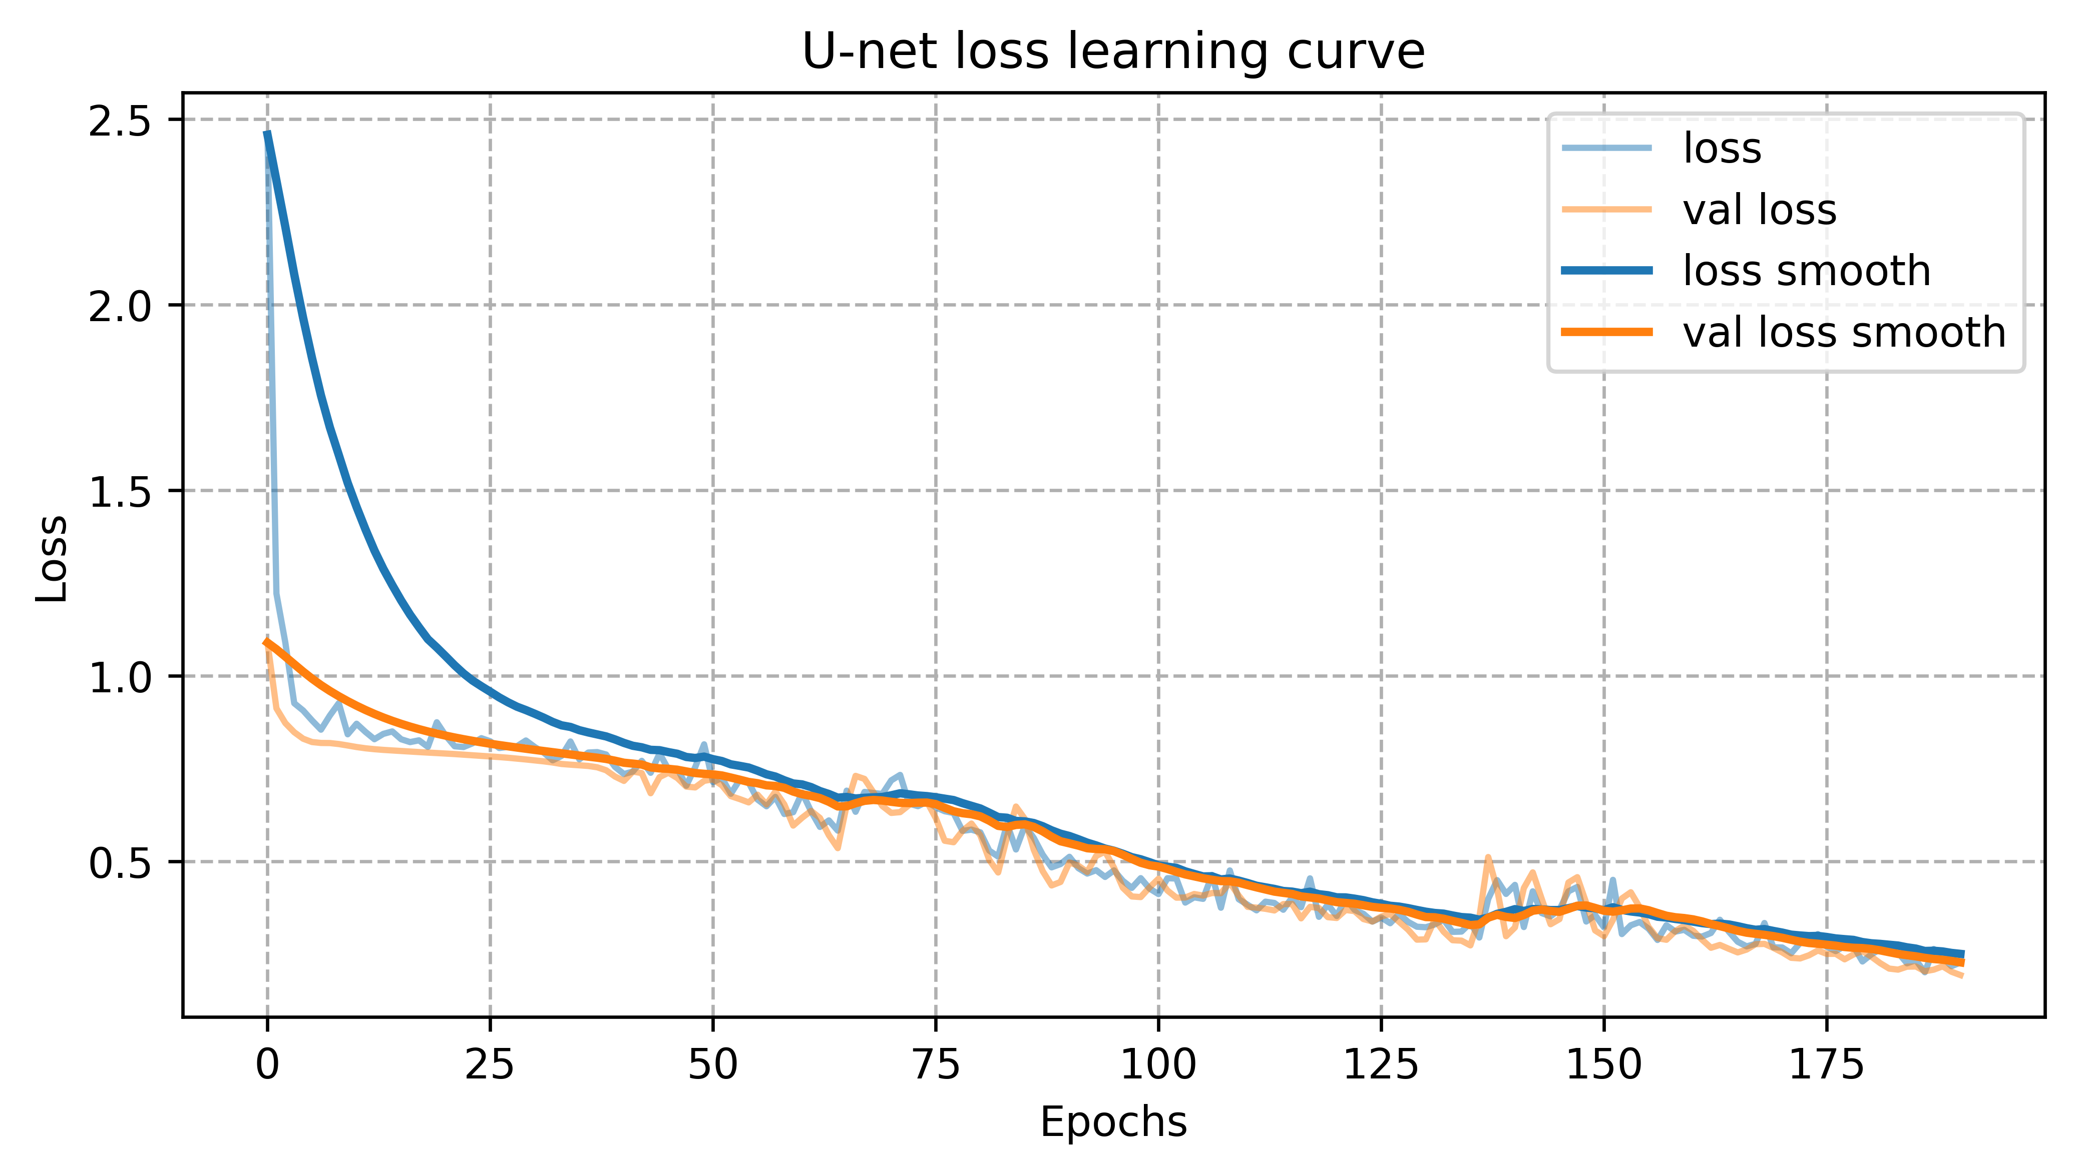
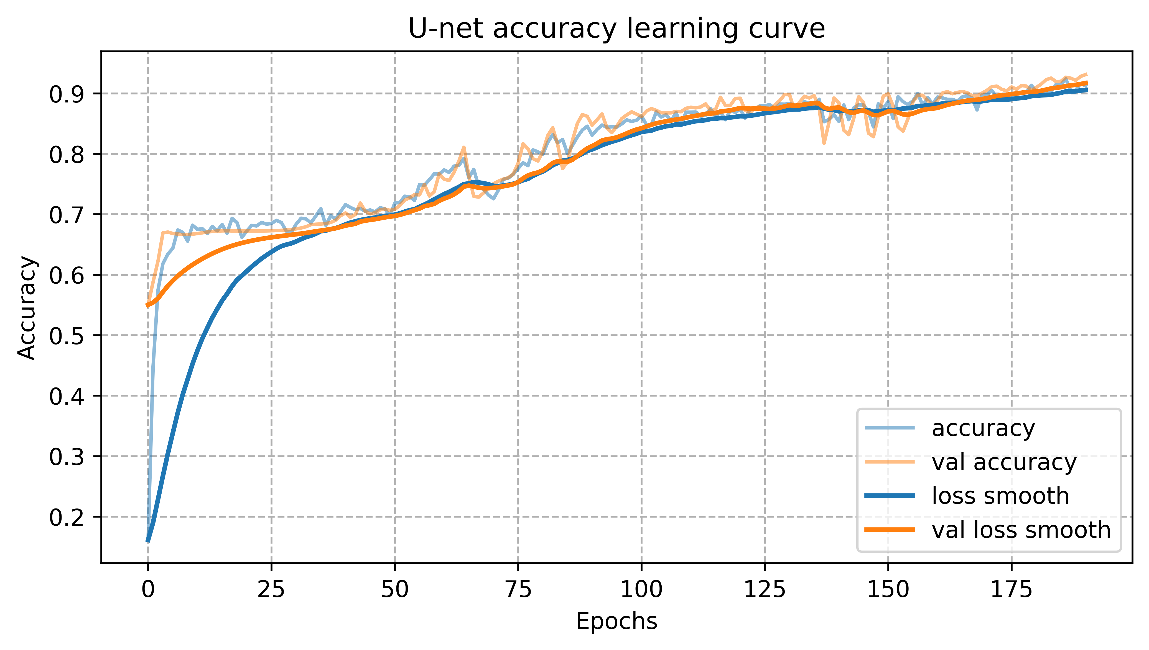
Object Segmentation
U Net (Final model Training):
Final Hyperparameters
Batch Size | Learning rate | Filter size | Optimizer
32 | 0.0001 | 6 [16,32,64,128,256,512] | Adam

Slide 25
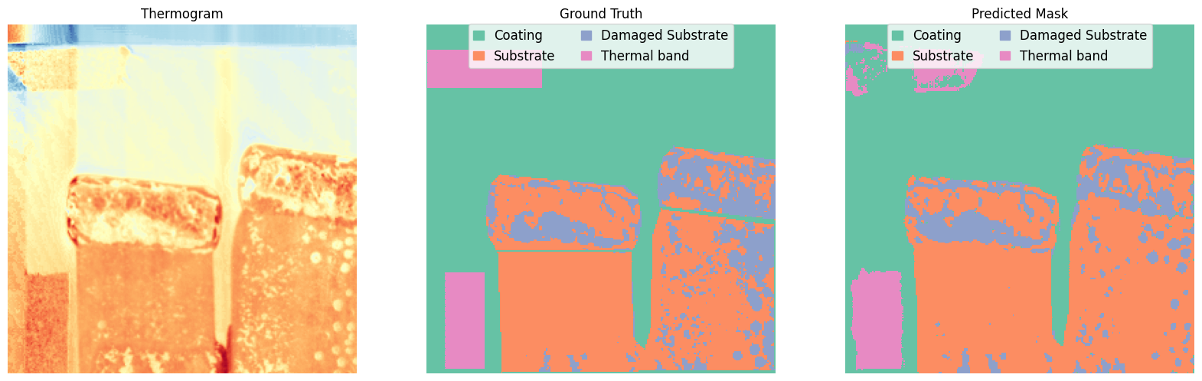
Object Segmentation
U Net (Evaluation):
Input thermogram (left), expected output (center), and predicted mask(right) on training data(U-Net)
Accuracy : 92.27%

Slide 26
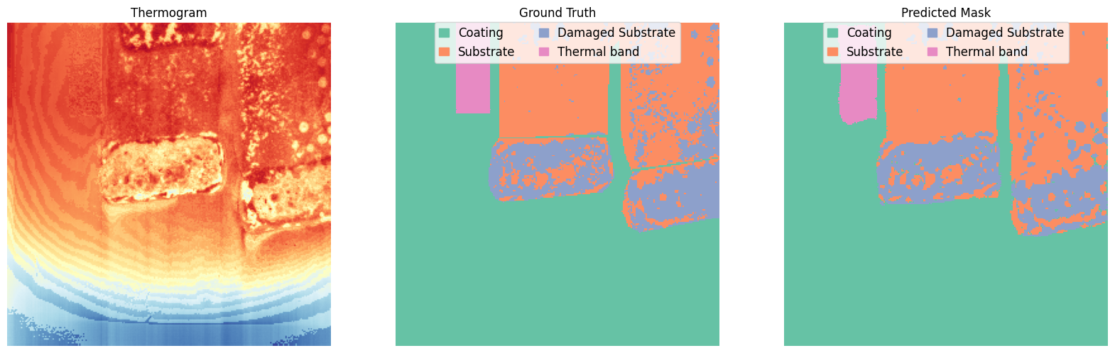
Object Segmentation
U Net (Evaluation):
Input thermogram (left), expected output (center), and predicted mask(right) on testing data(U-Net)
Accuracy : 92.21%

Slide 27
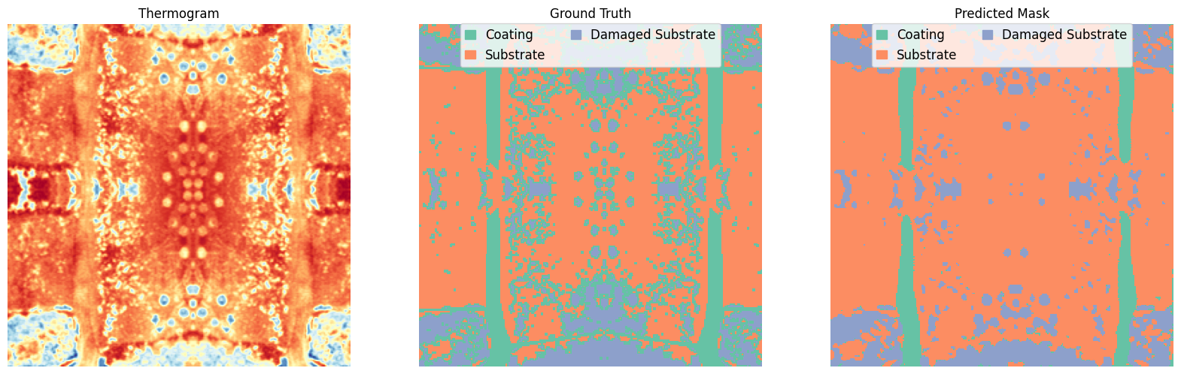
Object Segmentation
U Net (Evaluation):
Input thermogram (left), expected output (center), and predicted mask(right) on augmented data(U-Net)
Accuracy : 93.35%

Slide 28
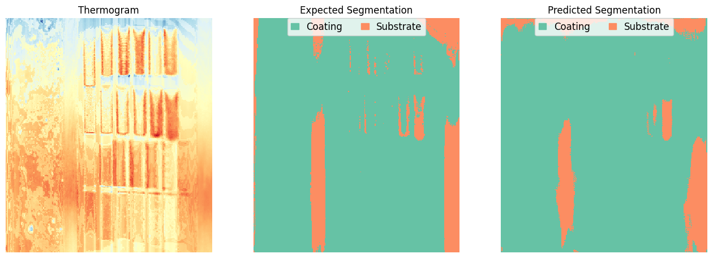
Object Segmentation
U Net (Evaluation):
Input thermogram (left), expected output (center), and predicted mask(right) on metal data(U-Net)
Accuracy : 89.27%

Slide 29
Object Segmentation
Overall performance index (Accuracy):
Pyramid Scene Parsing Network (PSP Net)
Fully Convolution Network (FCN)
U-Net
Architecture | PSP-Net | FC-Net | U-Net
Training Dataset | 86.81% | 86.55% | 92.47%
Validation Dataset | 86.06% | 90.35% | 92.62%
Test Dataset | 86.30% | 85.73% | 92.22%

Slide 30
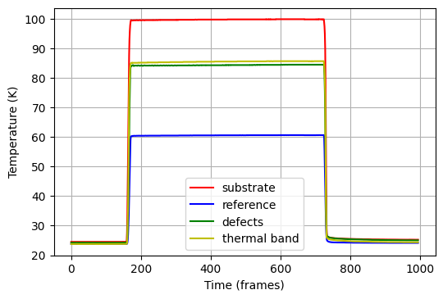
Thermogram Post-Processing
Thermal Profile:
Thermograms
Segmentation mask from U-Net
Thermal profile of all features extracted from segmentation mask

Slide 31
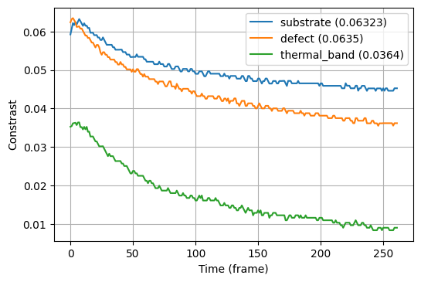
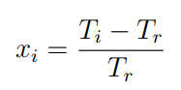
Thermogram Post-Processing
Contrast Function (depth evaluation):
(֯C)
(Contrast Function)
Thermal profile of all features extracted from segmentation mask
Where
x_{i} is the contrast value at the time i,
T_{i} is the feature temperature at the time i,
T_{r} is the reference or surrounding temperature at the time i.

Slide 32
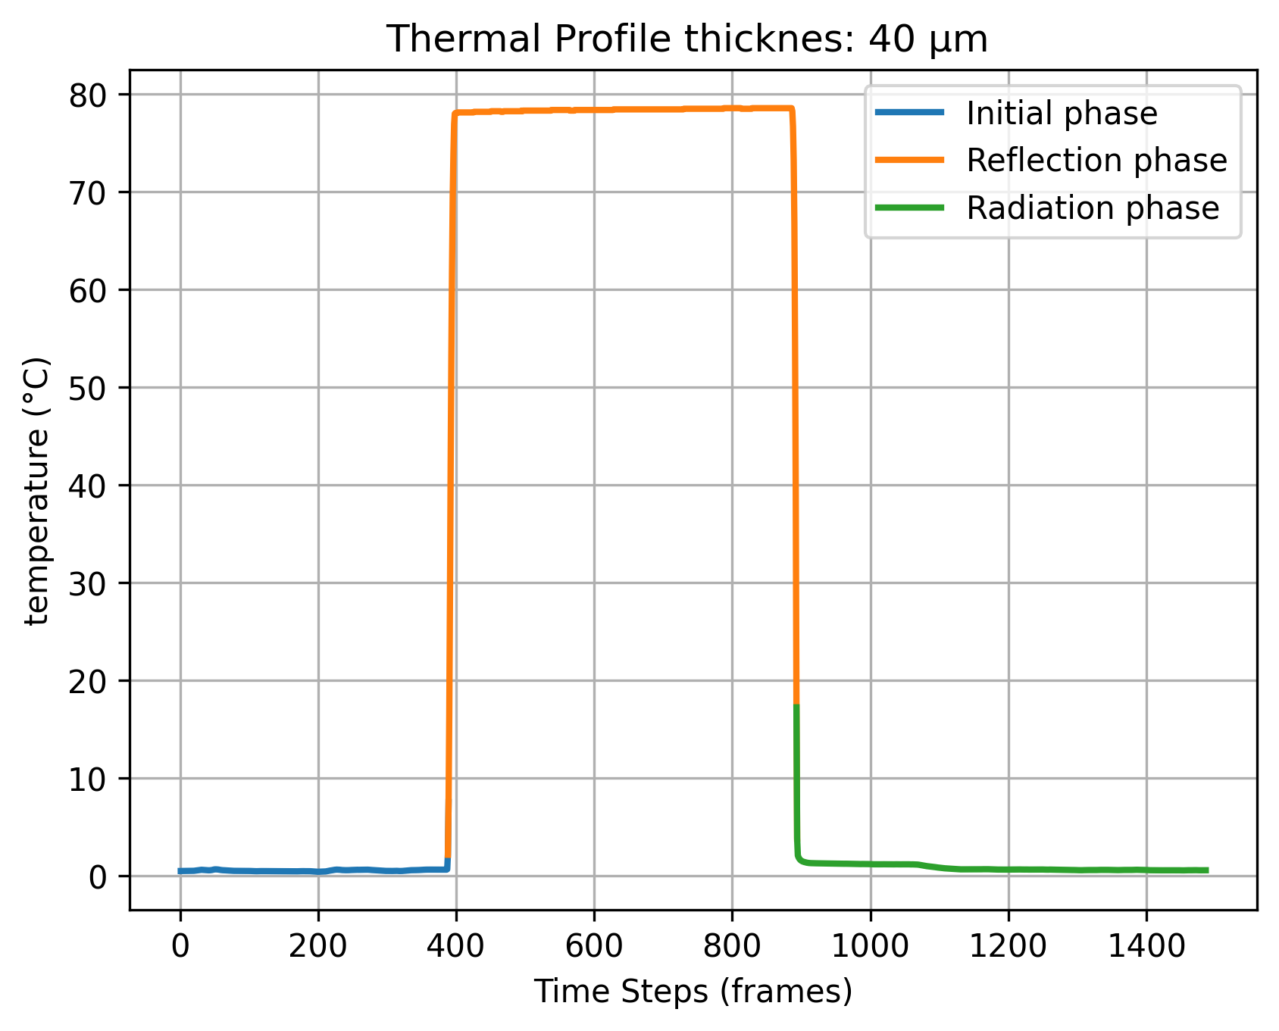
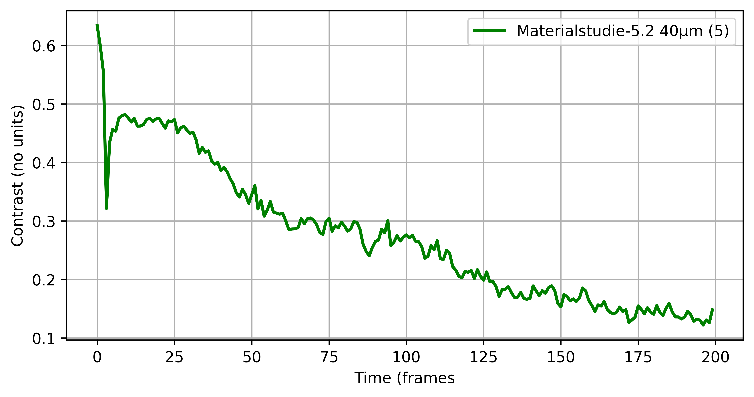
Thermogram Post-Processing
Contrast Function (Thickness evaluation):
(Contrast Function)
Where
x_{i} is the contrast value at the time i,
T_{i} is the feature temperature at the time i,
T_{r} is the average temperature in the reflection phase.
Thermal profile if no features are detected

Slide 33
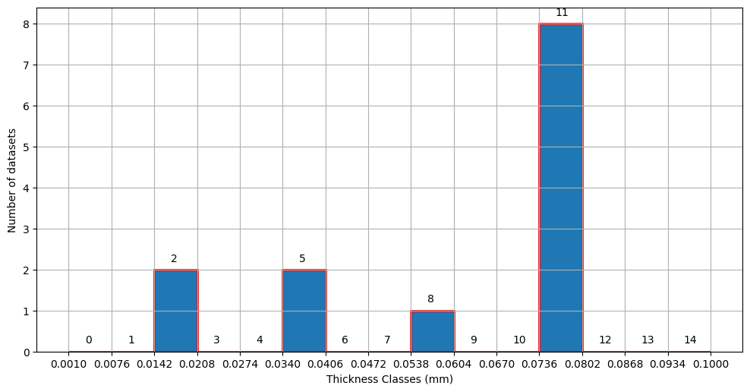
Thickness Evaluation
Thickness classification dataset generation:
Experiment name | Thickness (mm) | Class
Materialstudie-5.3-40µm_S1013_40µm_S1013-1000W-10s | 0.08 | 11
Materialstudie-5.2-40µmS1013-1000W-10s | 0.04 | 5
Dataset | Size (No of experiments) | Type (reflection phase time)
Training dataset | 19 | 10 sec
Validation dataset | 6 | 5 sec
Thickness classification histogram

Slide 34
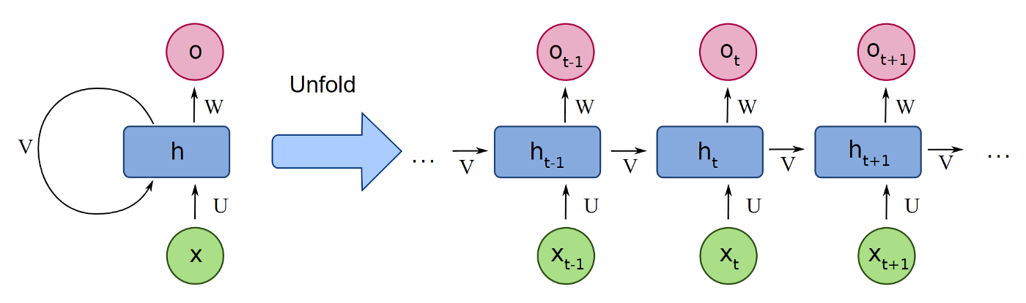
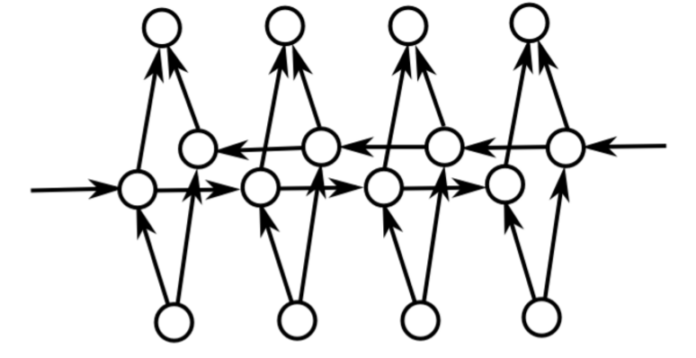
Thickness Evaluation- Neural Network Basics
Recurrent Neural Networks:
Basic RNN unit [15]
Where
x: The input,
O: The output at the time step,
y: Final output of RNN
h: The main block of the RNN. It contains the weights and the activation functions of the network,
V: Represents the weight which is carried to the net time step
Bi-direction input [16]

Slide 35
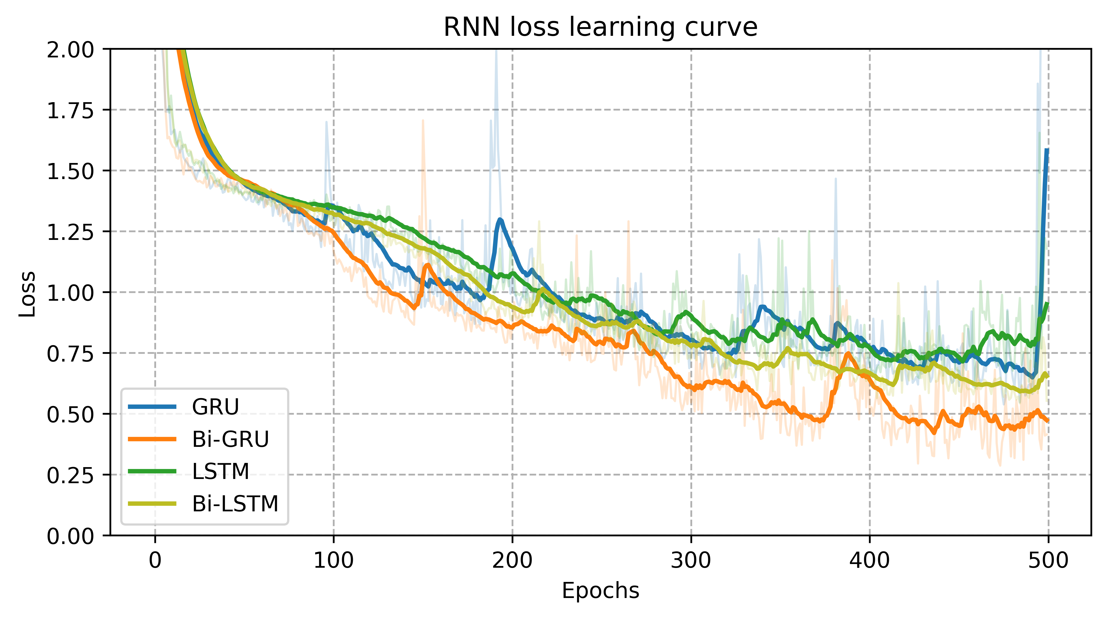
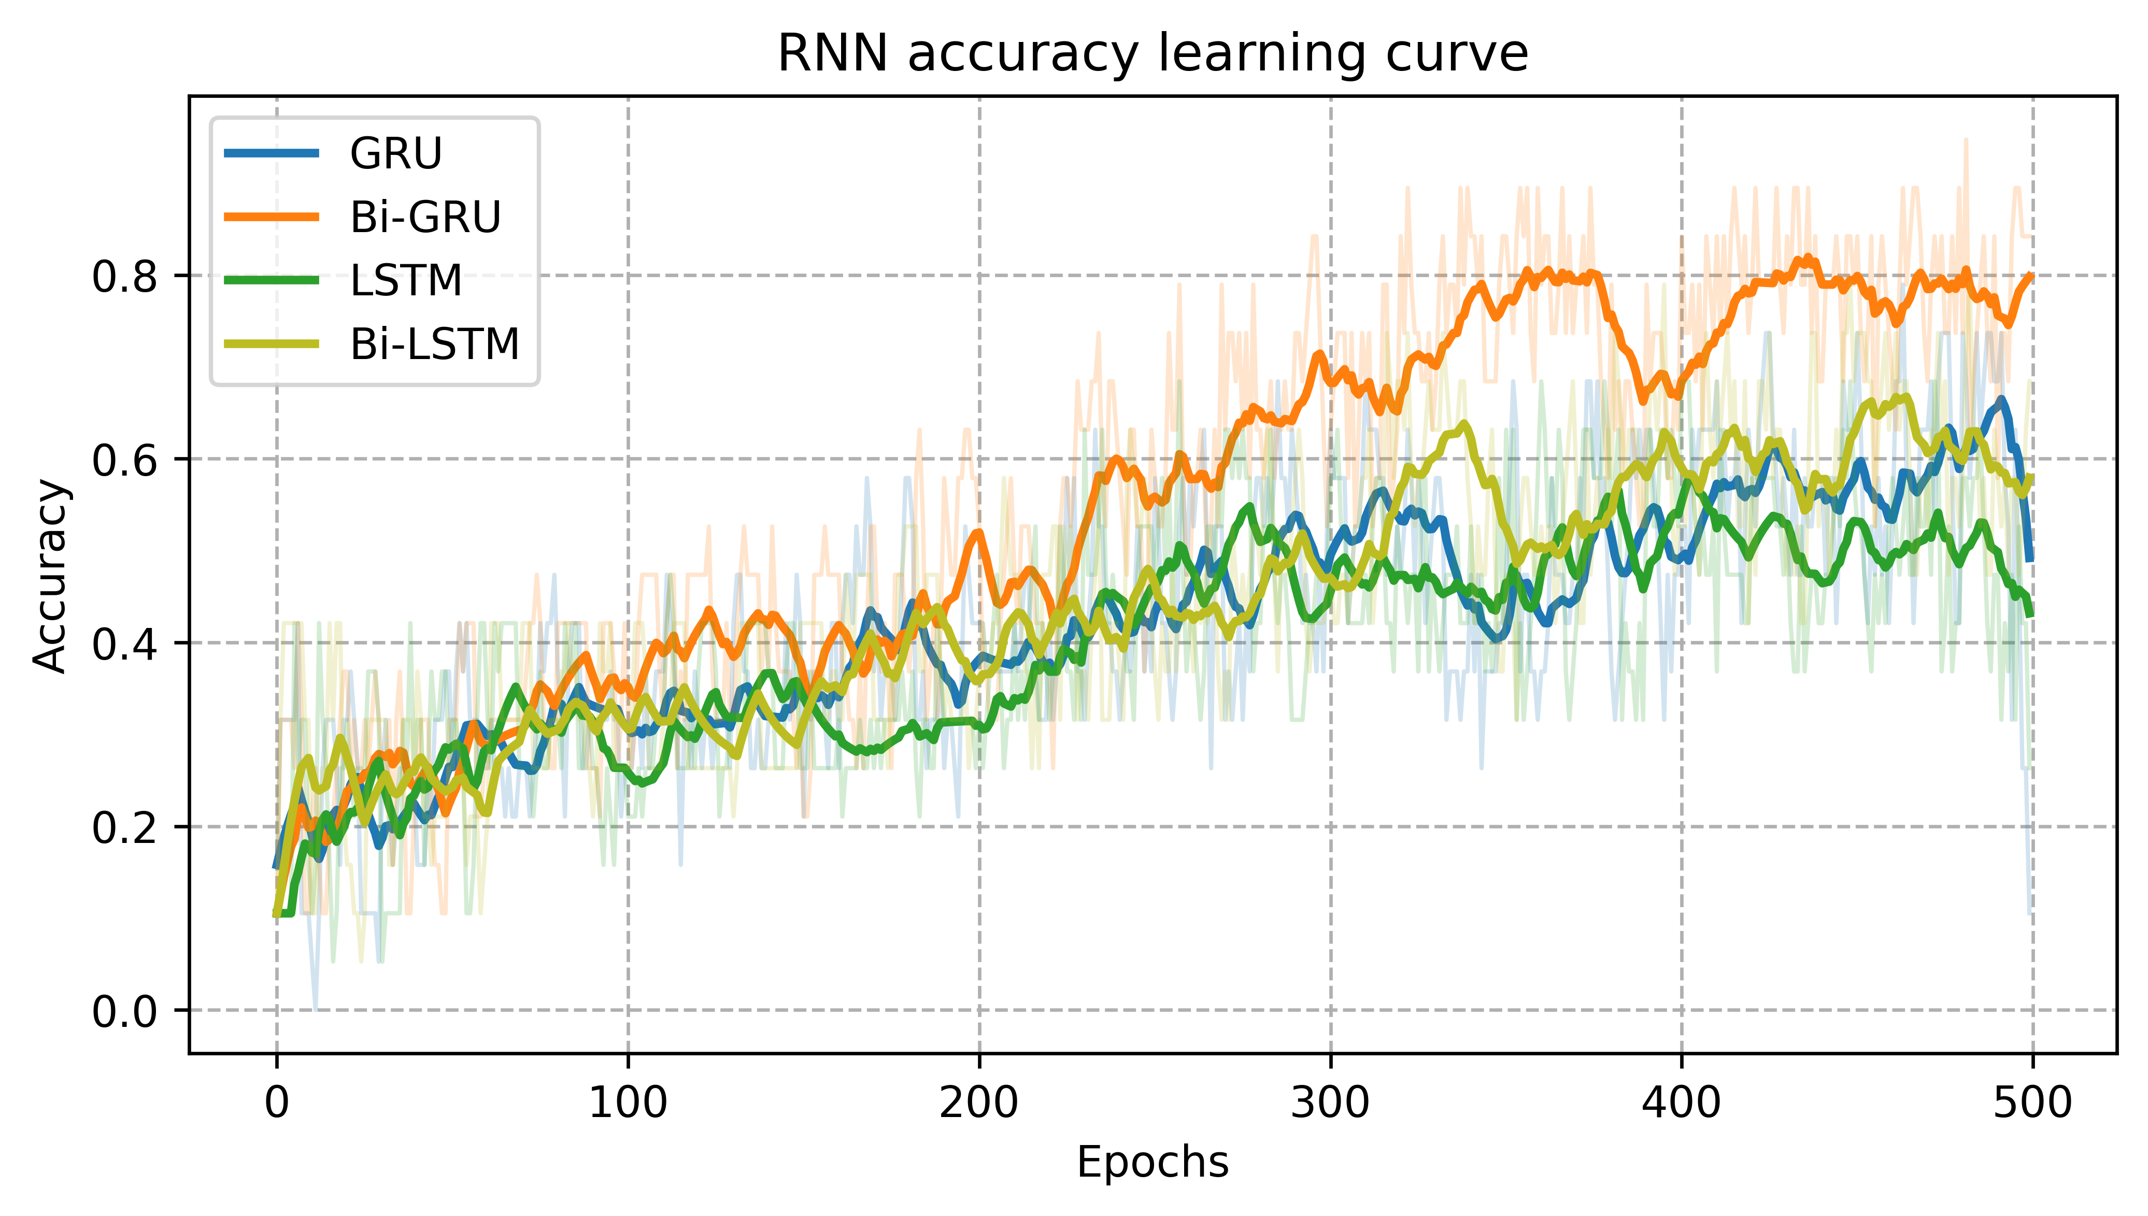
Appendix -Thickness Evaluation
Recurrent Neural Networks (Experimentation –type of architecture):
Hyperparameters
Batch Size | Learning rate | Constrast Function | RNN type | Optimizer
8 | 0.0001 | Average | ? | Adam

Slide 36
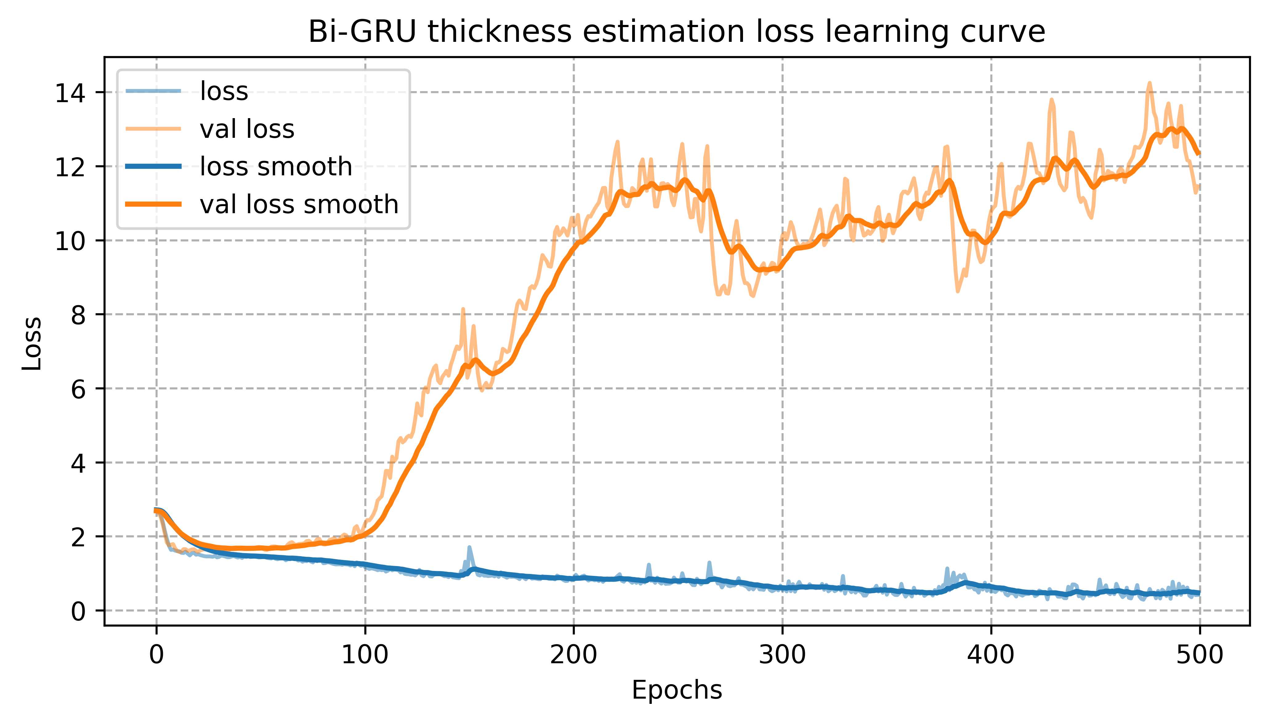
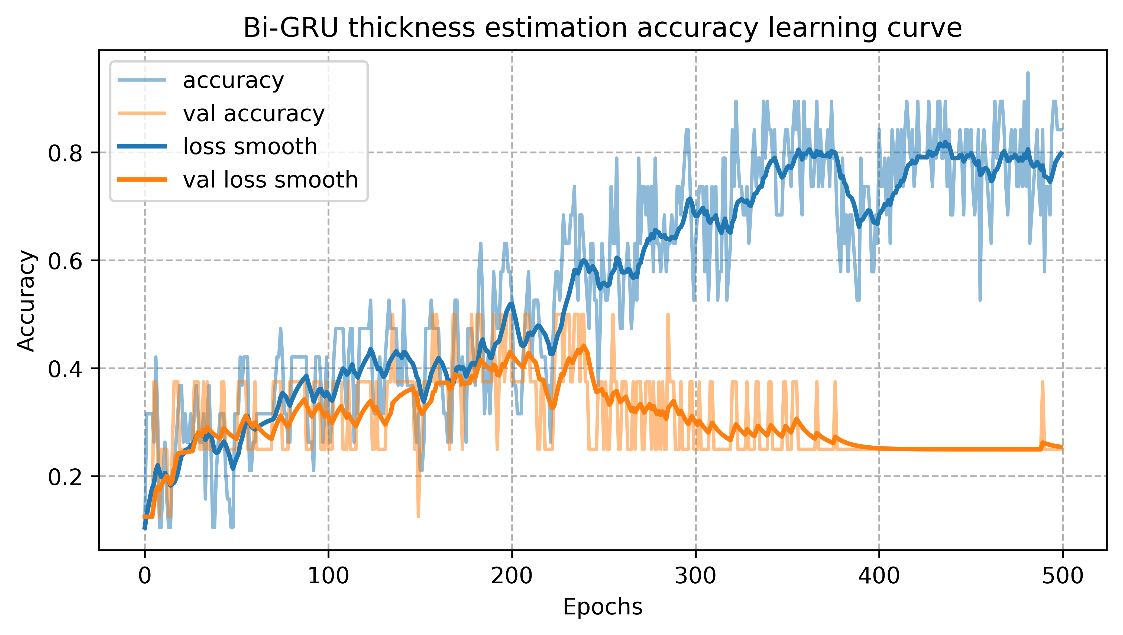
Thickness Evaluation
Recurrent Neural Networks (Final model training):
Final Hyperparameters
Batch Size | Learning rate | Constrast Function | RNN type | Optimizer
8 | 0.0001 | Average | Bi-GRU | Adam

Slide 37



Thickness Evaluation
Recurrent Neural Networks (Evaluation):
Thermal profiles
Analysis of a few incorrectly classified thicknesses

Slide 38
Thickness Evaluation
Overall performance index (Loss and accuarcy on training dataset):
Long-Short Term Memory (LSTM)
Gated Recurrent Unit (GRU)
Bi-directional LSTM
Bi-directional GRU
RNN Architecture | Loss | Accuarcy
LSTM | 1.2301 | 32.58%
GRU | 2.3292 | 21.05%
Bi-LSTM | 0.6114 | 73.68%
Bi-GRU | 0.2288 | 89.47%

Slide 39

Summary

Slide 40
Conclusion
Extraction of thermograms without any other software and seamlessly integrated it with existing code.
Existing code is modified to support a big data framework and GUI is developed for data extraction.
Extracted features from thermograms using object segmentation algorithms like U-Net, FCN8, and PSP.
The object segmentation models are trained with augmented data to improve their robustness and flexibility.
A more varied dataset is needed to improve the robustness of the thickness and depth estimation model (50,000 samples).
The depth estimation module is influenced by various external factors which are initial temperature, time period of heat source, etc.

Slide 41
References
A. Anthofer, P. K¨ogler, C. Friedrich, W. Lippmann, O. Peise, S. Voss, A. Hurtado, and D. Trimis, “Laserdekontamination von pcb-haltigen lackschichten,” Energy Policy, vol. 137, p. 111125, 2020
R. Usamentiaga and D. F. Garca, \Infrared thermography sensor for temperature and speed measurement of moving material," Sensors, vol. 17, no. 5, p. 1157, 2017.
K. I. Schultz, M. W. Kelly, J. J. Baker, M. H. Blackwell, M. G. Brown, C. B. Colonero, C. L. David, B. M. Tyrrell, and J. R. Wey, “Digital-pixel focal plane array technology,” Lincoln Laboratory Journal, vol. 20, no. 2, pp. 36–51, 2014
Andreas Pestel, Sven Eckart, and Hartmut Krause. Entwicklung eines echtzeit-detektionssystems zur identifizierung von lack- und farbschichten auf betonoberfl¨achen. 05 2021.
Aoun, Najib & El'arbi, Maher & Ben Amar, Chokri. (2012). Wavelet Transform Based Motion Estimation and Compensation for Video Coding. 10.5772/35998.
H. Goh, “Continuous Fourier transform: A practical approach for truncated signals and suggestions for improvements in thermography,” 07 2019
Yamashita, R., Nishio, M., Do, R.K.G. et al. Convolutional neural networks: an overview and application in radiology. Insights Imaging 9, 611–629 (2018). https://doi.org/10.1007/s13244-018-0639-9
https://towardsdatascience.com/intuitively-understanding-convolutions-for-deep-learning-1f6f42faee1
Basics of Convolutional neural networks (weebly.com)
Batch Normalization: Accelerating Deep Network Training by Reducing Internal Covariate, Shift Sergey and Christian Szegedy

Slide 42
References
Batch Normalization: Accelerating Deep Network Training b y Reducing Internal Covariate, Shift Sergey and Christian Szegedy
Dropout: A Simple Way to Prevent Neural Networks from Overfitting, Nitish Srivastava,Georey Hinton,Alex Krizhevsky,Ilya Sutskever,Ruslan Salakhutdinov. Journal of Machine Learning Research
12 Main Dropout Methods: Mathematical and Visual Explanation for DNNs, CNNs, and RNNs | by ⭐Axel Thevenot | Towards Data Science
Z. Hamdi, M. Brandmeier, and C. Straub, “Forest damage assessment using deep learning on high resolution remote sensing data,” Remote Sensing, vol. 11, 08 2019.
Deep Learning: Recurrent Neural Networks | by Pedro Borges | deeplearningbrasilia | Medium
Gridach, Mourad. (2016). Character-Aware Neural Networks for Arabic Named Entity Recognition for Social Media.
H. Zhao, J. Shi, X. Qi, X. Wang, and J. Jia, \Pyramid scene parsing network,“ in Proceedings of the IEEE conference on computer vision and pattern recognition, pp. 2881{2890, 2017}.
S. Piramanayagam, E. Saber, W. Schwartzkopf, and F. Koehler, \Supervised classification of multisensor remotely sensed images using a deep learning framework," Remote Sensing, vol. 10, p. 1429, 09 2018

Slide 43
THANK YOU

Slide 44
DEMO
Data Extraction
Thermal profile
Object segmentation
Depth estimation
Thickness estimation
GUI

Slide 45


Appendix - Object Segmentation - Neural Network Basics
Activation function:
During Forward propagation, ReLU penalizes negative values to zero. Thus reducing the computation effort.
Activation Function’s operation [9]
Activation Function and its derivatives feature map [9]

Slide 46
Appendix - Object Segmentation - Neural Network Basics
Pooling layer:
To prevent overfitting, a pooling layer is applied after the convolution layer.
Max, Average is different types of pooling layers.
Pooling layer removes distortion in inputs and preserves essential features.
Max pooling operation [8]
Polling operation to show the reduction in noise [8]

Slide 47


Appendix - Object Segmentation - Neural Network Basics
Dropout layer:
Dropout is a regularization technique used in NN to prevent overfitting. It lower generalization errors.
Max pooling operation combined with dropout layer [12]
Dropout operation[12]

Slide 48


Appendix - Object Segmentation - Neural Network Basics
Batch Normalization layer:
BN is applied after convolution operation before assigning non-linearity.
Batch Normalization algorithm [10]
Batch Normalization [11]
The learnable parameter (γ and β) are updated during back-propagation.

Slide 49

Appendix - Object Segmentation - Neural Network Basics
Gradient Descent:
In CNN, we try to minimize the loss function.
Adam optimization is a mostly commonly used gradient descent method.
Gradient descent [8]
Learning rate α is the hyperparameter of gradient descent.

Slide 50


Appendix - Object Segmentation
U Net (Experimentation- Batch Size):
Hyperparameters
Batch Size | Learning rate | Filter size | Optimizer
? | 0.001 | 4 | SGD

Slide 51

Appendix
PSP-Net (Architecture):
A basic Pyramid Scene Parsing Network architecture [17]
Trainable parameters | Non-Trainable parameters | Total Parameters
2,09,916 | 1352 | 2,11,268

Slide 52

Appendix
PSP-Net (Evaluation):
Input thermogram (left), expected output (center), and predicted mask(right) on test data (PSP-Net)
Accuracy : 81.56%

Slide 53

Appendix
Fully convolution Network (Architecture):
A basic FCN8 architecture[18]
Trainable parameters | Non-Trainable parameters | Total Parameters
14,751,956 | 0 | 14,751,956

Slide 54

Appendix
FCN8 (Evaluation):
Input thermogram (left), expected output (center), and predicted mask(right) on augmented data (FCN8)
Accuracy : 85.56%

Slide 55


Appendix - Thickness Evaluation
Recurrent Neural Networks ( Experimentation –contrast function):
Hyperparameters
Batch Size | Learning rate | Constrast Function | RNN type | Optimizer
8 | 0.0001 | ? | LSTM | Adam

Slide 56


Appendix
Software Architecture:
List of examples codes to run the packages
List of packages

Slide 57





Appendix
GUI:

